Slide 1





Differential analysis of RNA-Seq data: design, describe, explore and model
Ecole de Bioinformatique AVIESAN/IFB/Inserm – Roscoff – Nov. 2023
Elise Jacquemet – elise.jacquemet@pasteur.fr
Bioinformatics and Biostatistics Hub - Institut Pasteur - Université de Paris, Paris, France

Slide 2


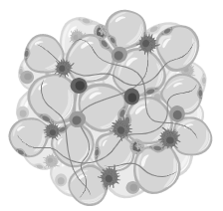
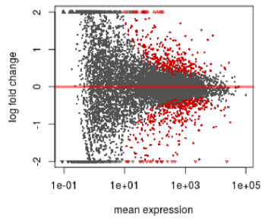
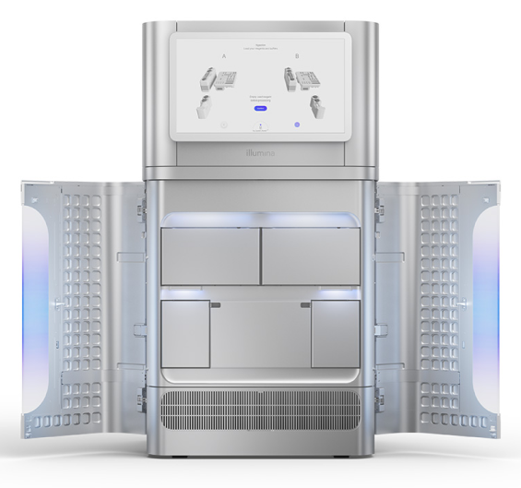
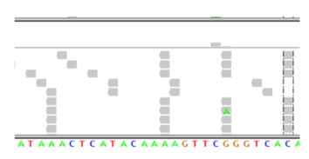
Main RNA-Seq steps
Tissue/cells
RNA
cDNA Library
Designing the experiment and the sequencing
Differential analysis
Bioinformatics
Sequencing

Slide 3
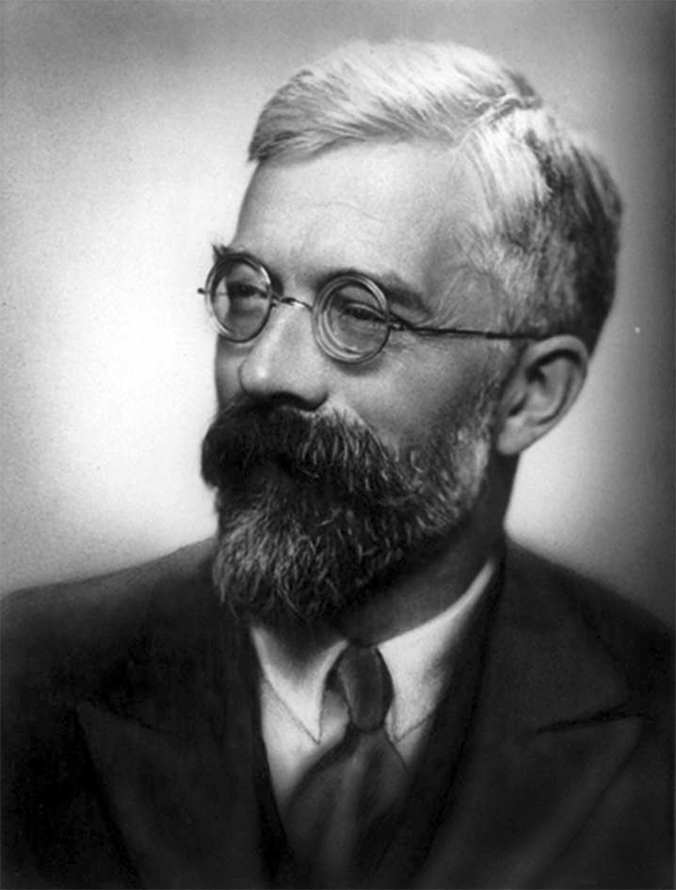
Citations
"To consult a statistician after an experiment is finished is often merely to ask him to conduct a post-mortem examination. He can perhaps say what the experiment died of."
Ronald A. Fisher, Indian Statistical Congress, 1938, vol. 4, p 17
“While a good design does not guarantee a successful experiment, a suitably bad design guarantees a failed experiment”
Kathleen Kerr, Atelier Inserm 145, 2003

Slide 4
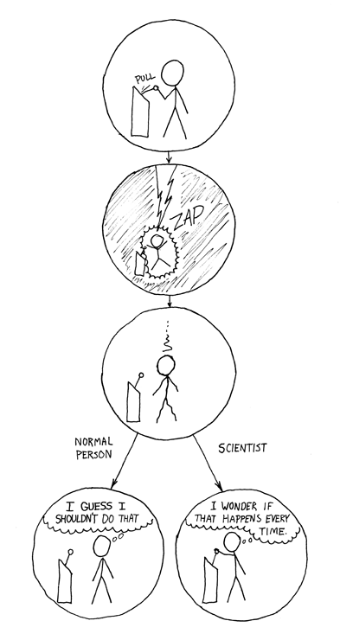
Statistical modeling
Goal of an experiment: address one biological question
Result of an experiment: many numerical values
Statistical modeling consists in using a
mathematical formula involving:
Experimental conditions X
Numerical values measured Y
Parameters β linking X and Y (to be estimated), e.g.:
Y ∼ Xβ + ε
Some hypotheses on the data variability/law, e.g.:
ε ∼ Gaussian(0, σ²)

Slide 5
Starting point of the differential analysis
 | T0-1 | T0-2 | T0-3 | T4-1 | T4-2 | T4-3 | T8-1 | T8-2 | T8-3
gene1 | 151 | 131 | 183 | 31 | 35 | 44 | 19 | 31 | 18
gene2 | 142 | 134 | 153 | 650 | 629 | 783 | 136 | 241 | 151
gene3 | 157 | 147 | 166 | 7 | 10 | 20 | 8 | 10 | 8
gene4 | 275 | 249 | 342 | 70 | 44 | 91 | 75 | 64 | 62
gene5 | 4 | 5 | 2 | 0 | 0 | 1 | 2 | 2 | 3
gene6 | 2 | 0 | 1 | 0 | 1 | 2 | 7 | 3 | 3
gene7 | 4 | 7 | 3 | 0 | 0 | 0 | 0 | 0 | 0
gene8 | 10 | 16 | 10 | 28 | 12 | 10 | 16 | 33 | 23
gene9 | 12 | 20 | 24 | 74 | 84 | 77 | 10 | 10 | 9
gene10 | 269 | 262 | 379 | 112 | 132 | 138 | 44 | 33 | 48
gene11 | 10065 | 9593 | 11955 | 4076 | 3739 | 4137 | 2736 | 3311 | 2749
gene12 | 651 | 566 | 819 | 101 | 86 | 74 | 97 | 87 | 96
gene13 | 118 | 116 | 150 | 18 | 24 | 42 | 15 | 8 | 5
... | ... | ... | ... | ... | ... | ... | ... | ... | ...
geneN | 18 | 31 | 39 | 4 | 4 | 7 | 2 | 6 | 2
Goal: find genes differentially expressed between biological conditions

Slide 6
Vocabulary
Design file:
Example:
Samples | VariableV | FactorF
ReplicateA-1 | levelA | biologicalConditionX
ReplicateA-2 | levelA | biologicalConditionY
ReplicateB-1 | levelB | biologicalConditionX
ReplicateB-2 | levelB | biologicalConditionY
id | strain | day
WT-1 | WT | d1
WT-2 | WT | d2
WT-3 | WT | d3
KO-1 | KO | d1
KO-2 | KO | d2
KO-3 | KO | d3

Slide 7
Outline
Introduction
Designing the experiment
Description/exploration
Normalization
Modeling
SARTools

Slide 8
Why an experimental design?
To control the variability during the experiment in order to be able to address the biological question:
What is the biological question?
How to estimate the associated biological variabilities?
How to control the technical variabilities (day, lane, run, etc.)?
Biological or technical uncontrolled effects could:
Hide/cancel the biological effect of interest
Wrongly increase the biological effect of interest
“Ensure that the right type of data, and enough of it, is available to answer the questions of interest as clearly and efficiently as possible”
http://www.stats.gla.ac.uk/steps/glossary/anova.html#expdes

Slide 9

Why an experimental design?
“A good experimental design starts with a well-defined hypothesis [...]. The experimental design should aim to reduce the types and sources of variability, increase the generalizability of the experiment, and make it replicable and reusable. It is both easier and more cost efficient to identify and correct experimental design issues ahead of time than to address deficiencies thereafter. Thus, discussion between data-generating researchers and bioinformaticians is highly desirable and should occur as early as possible during project development and experimental design.”

Slide 10

Basic comparison
I want to ﬁnd differentially expressed genes between time
0 and time 24h on cultures of E. Coli
id | state
h1 | healthy
h2 | healthy
h3 | healthy
cf1 | CF
cf2 | CF
cf3 | CF
one factor of interest :
the state of the patients
this factor has two levels: healthy and CF
mRNA sequencing of lung cells.

Slide 11
Paired samples
I want to ﬁnd differentially expressed genes between time
0 and time 24h on cultures of E. Coli
id | state | RNA extraction date
h1 | healthy | June 12th, 2019
h2 | healthy | June 20th, 2019
h3 | healthy | June 25th, 2019
cf1 | CF | June 12th, 2019
cf2 | CF | June 20th, 2019
cf3 | CF | June 25th, 2019

Slide 12
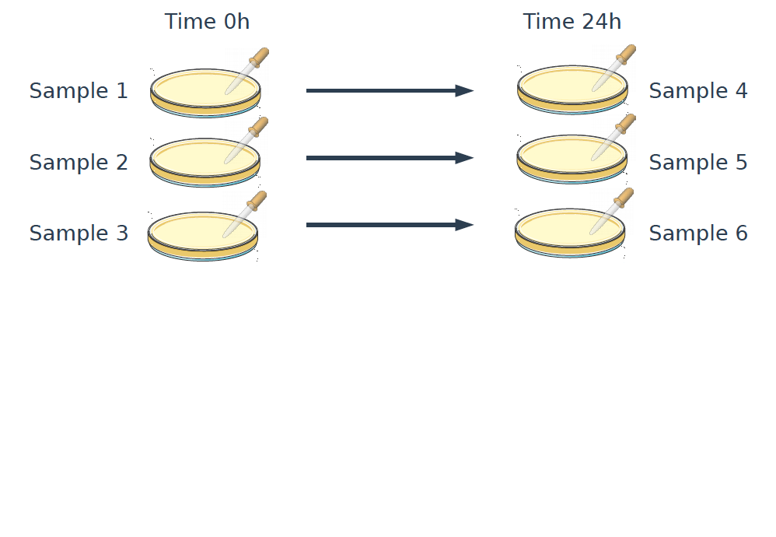
On the laboratory bench...
Time course experiment (paired)
I want to ﬁnd differentially expressed genes between time
0 and time 24h on cultures of E. Coli

Slide 13
On the laboratory bench...
Time course experiment (paired)
I want to ﬁnd differentially expressed genes between time
0 and time 24h on cultures of E. Coli

Slide 14
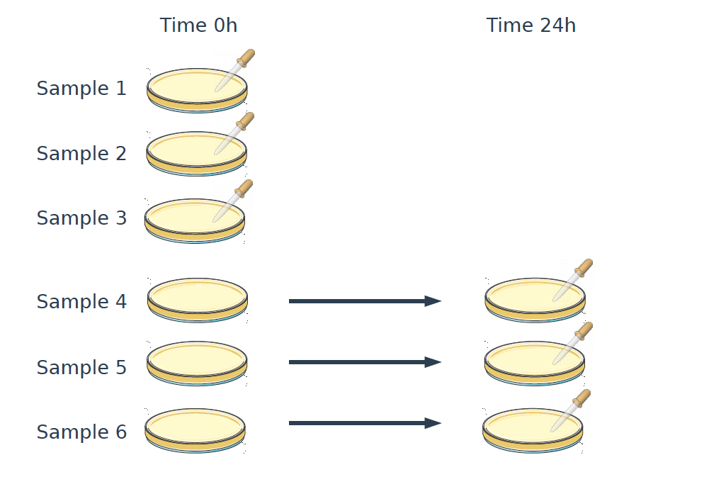
On the laboratory bench...
Time course experiment (unpaired)
I want to ﬁnd differentially expressed genes between time
0 and time 24h on cultures of E. Coli

Slide 15
Complex design
I want to study the effect of a virus infection level (high vs. low) on the transcriptome of two mouse strains (B6 vs. SEG).
id | strain | infection
m1 | B6 | low
m2 | B6 | low
m3 | B6 | high
m4 | B6 | high
m5 | SEG | low
m6 | SEG | low
m7 | SEG | high
m8 | SEG | high
Two factors of interest with
two levels each :
the infection level of the patients (low or high)
the mouse strain (SEG and B6)

Slide 16
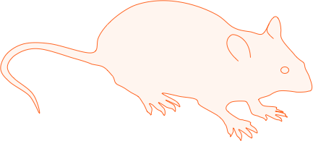
Interaction between two factors/variables
Infection
Low
High
m1
m2
m3
m4
B6
Strain
m5
m6
m7
m8
SEG

Slide 17
Interaction between two factors/variables
Infection
Interaction:
Is the infection effect different between the two strains?
Does the difference between the strains change according to the infection?
Low
High
m1
m2
m3
m4
B6
Strain
m5
m6
m7
m8
SEG

Slide 18
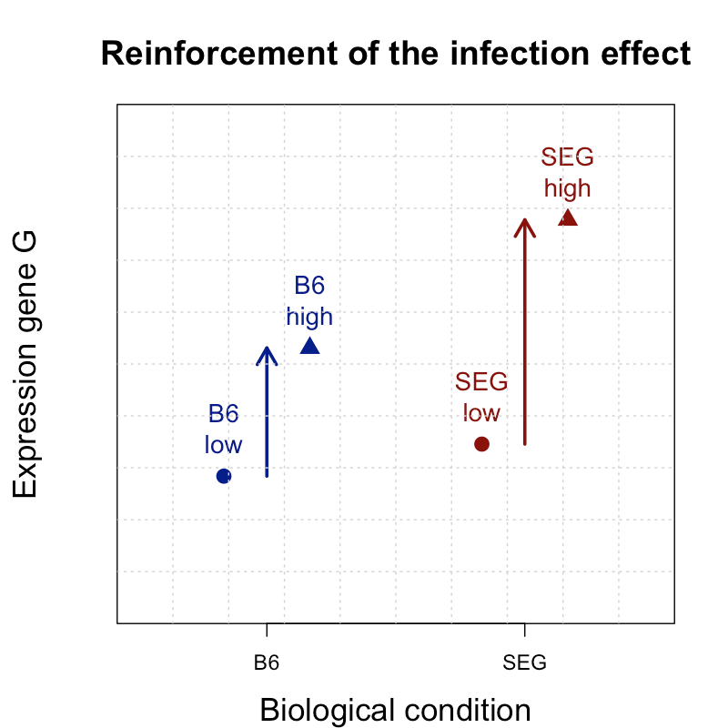
Examples of interactions

Slide 19
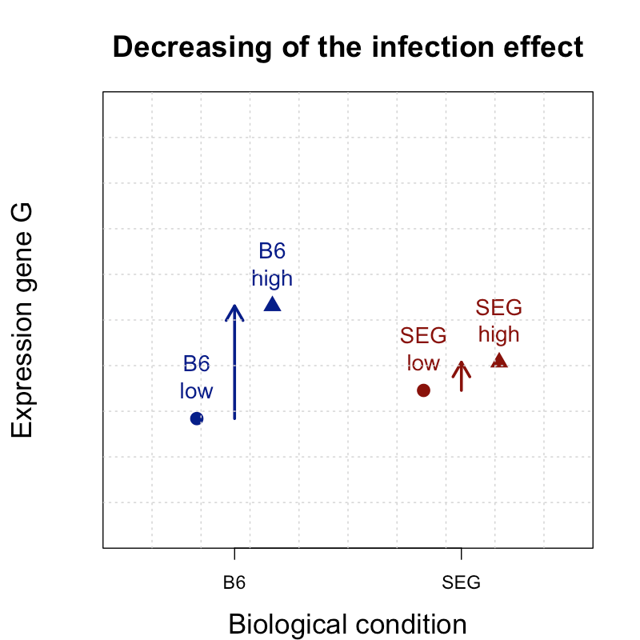
Examples of interactions

Slide 20
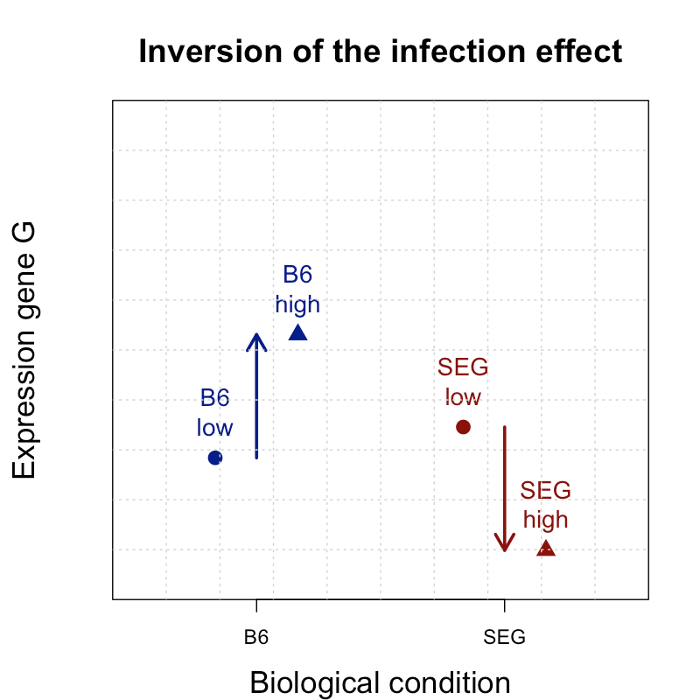
Examples of interactions

Slide 21
Complex design with nested factors
A treatment T is applied to two CF patients and two healthy people. We study the initial transcriptome and after 4h of treatment.
The "patient" effect need to be taken into account, but it is nested into the "state" effect.
id | state | time | patient
h1-0 | healthy | 0h | h1
h2-0 | healthy | 0h | h2
h1-4 | healthy | 4h | h1
h2-4 | healthy | 4h | h2
cf1-0 | CF | 0h | cf1
cf2-0 | CF | 0h | cf2
cf1-4 | CF | 4h | cf1
cf2-4 | CF | 4h | cf2

Slide 22
Be careful with confounding effects !
Comparison of lung cells in healthy and cystic ﬁbrosis patients
id | state | age | sex | RNA extraction day | experimentalist
h1 | healthy | 45 | female | July 9th, 2019 | Louis
h2 | healthy | 52 | female | July 12th, 2019 | Louis
h3 | healthy | 48 | female | July 15th, 2019 | Louis
cf1 | CF | 31 | male | Feb 20th, 2019 | Françoise
cf2 | CF | 25 | male | Feb 24th, 2019 | Françoise
cf3 | CF | 27 | male | Feb 29th, 2019 | Françoise

Slide 23

Be careful with confounding effects !
A gene is detected as being differentially expressed between healthy and CF patients. Is it due to:
Flawed design
The disease?
The sex effect?
The age effect?
The date effect?
The technician effect?
Status
Sex
low
low
17%
1%
82%
Age
low

Slide 24
Be careful with confounding effects !
Re-doing the experiment but making sure all levels of all factors are crossed to avoid any confusion
Crossed design
Possibility to distinguish every source of variability & their interaction :
The disease
The sex effect
The age effect
The date effect
The technician effect
Status
Sex
52%
low
18%
low
low
low
Age
29%

Slide 25
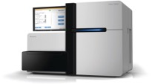




Biological vs. technical replicates
Technical replicates
Individual
RNA
Library
Sequencing
Biological replicates

Slide 26
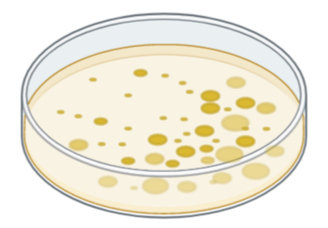
Biological vs. technical replicates in RNAseq
Technical replicates:
Several extractions of the same RNA
Several libraries built from the same RNA extraction
A library sequenced several times
Allow to get more sequencing depth and a better coverage. Need to sum the counts associated to each technical replicates.
Biological replicates:
Parallel measurements of biologically distinct samples
Correspond to the variability visible in the real life
Comment: what happens when studying fungi/yeast?
Notes:
random biological variation, which may itself be a
subject of study or a noise source.

Slide 27
Why replicate?
Perfect world:
No biological nor technical variability
Only one sample from each condition to conclude!
Our world:
Each individual has its own behavior
Need several biological replicates to handle variability

Slide 28
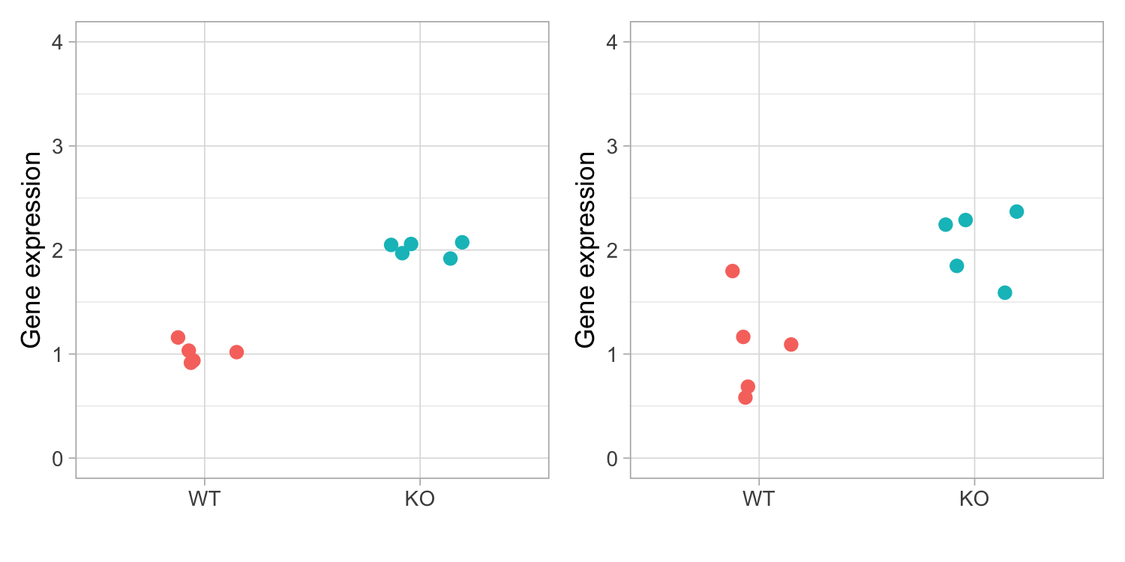
Why replicate?

Slide 29
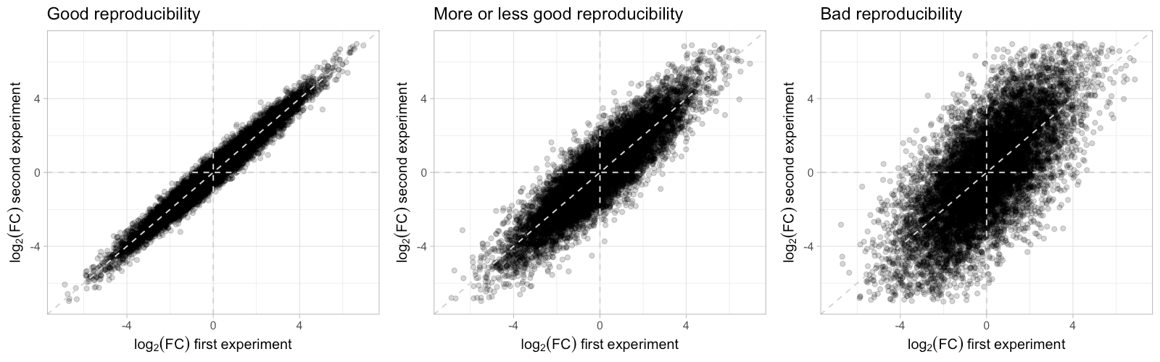
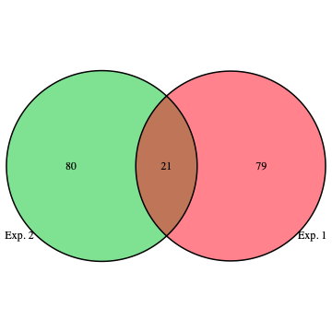
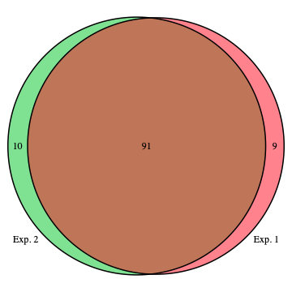
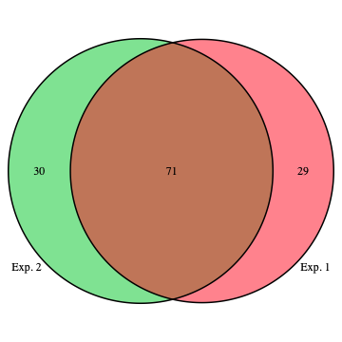
Reproducibility of an experiment: 3 KO vs 3 WT

Slide 30







Population: set of all mice we could measure
Sampling must be representative of the whole population under study !

Slide 31
Sampling 1: selection of 3 mice per condition

Slide 32
Sampling 2: non representative

Slide 33


Sequencing design
Goal:
Do not add any confounding technical effect (day, lane, run, etc.) to the factor of interest.
Bad example
Good example
Good example
Healthy 1
Healthy 2
Healthy 3
CF 1
CF 2
CF 3
Healthy 1
CF 2
Healthy 3
CF 1
Healthy 2
CF 3
Healthy 1
Healthy 2
Healthy 3
CF 1
CF 2
CF 3
Healthy 1
Healthy 2
Healthy 3
CF 1
CF 2
CF 3
Lane 1 Lane 2
Lane 1 Lane 2
Lane 1 Lane 2

Slide 34
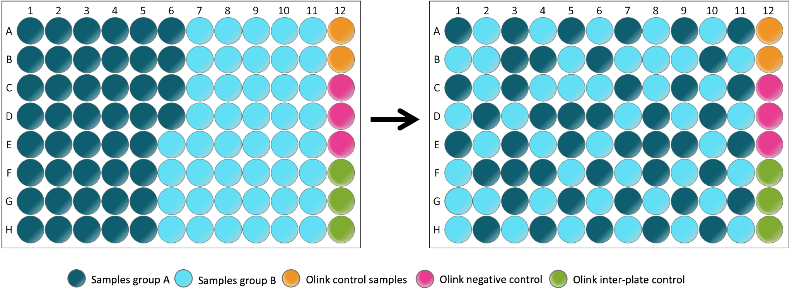
Sequencing design
Goal:
Do not add any confounding technical effect (day, lane, run, etc.) to the factor of interest.
Impossible to cross evenly all sources of technical variation
Randomize !

Slide 35

Sequencing design
Technical variabilities:
Lane
Flowcell
Run
lane effect < flowcell effect < run effect << biological variability
Use the same multiplexing rate for all the samples!

Slide 36
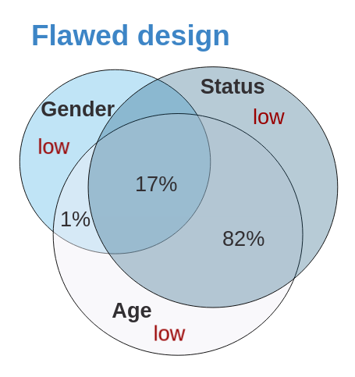
Experimental design : Take-home message
Express the biological question as accurately as possible to build an experimental design which will be able to address it.
The simpler, the better : If >2 factors, the results may be very difﬁcult to interpret
Identify all the sources of variability to avoid confounding effects
- Change of biological condition (e.g. KO vs WT)
- Within replicates variability (e.g. KO1 vs KO2 vs KO3)
- Experimentalist or day effect
- RNA: quality and extraction
- Library: PCR, concentration, random priming, rRNA removal
- Sequencing machine, flowcell and lane, …

Slide 37

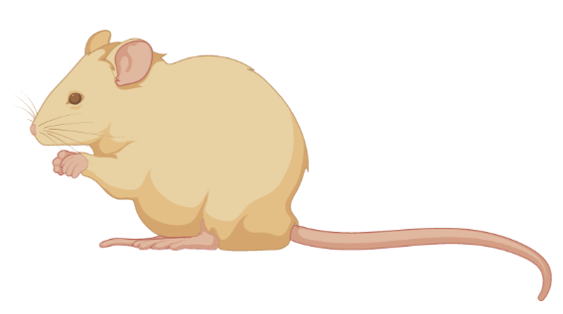

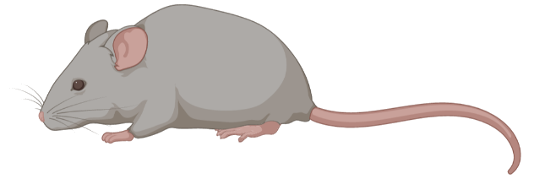
Experimental design : Take-home message
Experiments must be replicated to precisely measure the biological variability associated with the condition under study.
Sampling must be representative of the whole population under study
The higher the within group variability … the higher the number of biological replicates, in order to make sure that the whole range of variation is covered
Ideally, use blocking … to ensure that the biological conditions are evenly distributed among factors that are important unwanted) sources of variability.
… or randomization when blocking is not possible

Slide 38
Outline
Introduction
Designing the experiment
Description/exploration
Normalization
Modeling
SARTools

Slide 39
Starting point of the differential analysis
 | T0-1 | T0-2 | T0-3 | T4-1 | T4-2 | T4-3 | T8-1 | T8-2 | T8-3
gene1 | 151 | 131 | 183 | 31 | 35 | 44 | 19 | 31 | 18
gene2 | 142 | 134 | 153 | 650 | 629 | 783 | 136 | 241 | 151
gene3 | 157 | 147 | 166 | 7 | 10 | 20 | 8 | 10 | 8
gene4 | 275 | 249 | 342 | 70 | 44 | 91 | 75 | 64 | 62
gene5 | 4 | 5 | 2 | 0 | 0 | 1 | 2 | 2 | 3
gene6 | 2 | 0 | 1 | 0 | 1 | 2 | 7 | 3 | 3
gene7 | 4 | 7 | 3 | 0 | 0 | 0 | 0 | 0 | 0
gene8 | 10 | 16 | 10 | 28 | 12 | 10 | 16 | 33 | 23
gene9 | 12 | 20 | 24 | 74 | 84 | 77 | 10 | 10 | 9
gene10 | 269 | 262 | 379 | 112 | 132 | 138 | 44 | 33 | 48
gene11 | 10065 | 9593 | 11955 | 4076 | 3739 | 4137 | 2736 | 3311 | 2749
gene12 | 651 | 566 | 819 | 101 | 86 | 74 | 97 | 87 | 96
gene13 | 118 | 116 | 150 | 18 | 24 | 42 | 15 | 8 | 5
... | ... | ... | ... | ... | ... | ... | ... | ... | ...
geneN | 18 | 31 | 39 | 4 | 4 | 7 | 2 | 6 | 2
Goal: find genes differentially expressed between biological conditions

Slide 40
Many plots to produce
Description sample by sample:
Total number of reads
Percentage of null counts
Percentage of reads caught by the most expressed gene
Distribution of the counts
Multivariate description of the data:
SERE coefficient for each pair of samples [2]
Principal Component Analysis
Hierarchical clustering

Slide 41
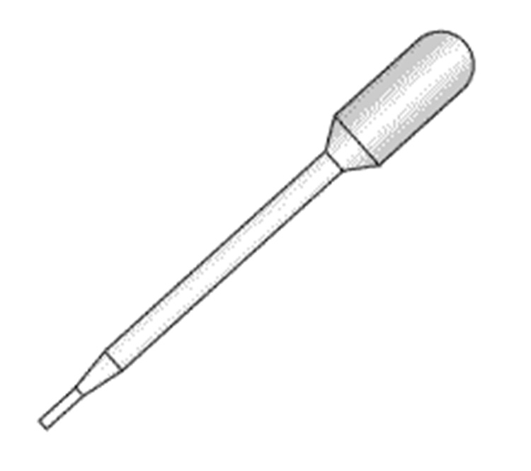
Distribution of counts data
“It is a good approximation to say that there is a linear relationship between read counts resulting from a sequencing experiment and the abundance of each sequence in the starting RNA material.” [1]
Random sampling
Library: M fragments of RNA
Lane: N << M fragments
RNA fragments from gene G
RNA fragments from other genes

Slide 42
Distribution of counts data
Let π_{G} = proportion of fragments of gene G:
{read R comes from gene G} ~ Bernoulli(π_{G})
Thus:
X_{G} = nb. of reads from gene G ~ Binomial(N, π_{G}) ≈ Poisson(Nπ_{G})
Random sampling
Library: M fragments of RNA
Lane: N << M fragments
RNA fragments from gene G
RNA fragments from other genes

Slide 43
Distribution of counts data
With a deeper sequencing (i.e. larger N):
Higher probability to catch lowly expressed genes
Higher precision when estimating π_{G}
Random sampling
Library: M fragments of RNA
Lane: N << M fragments
RNA fragments from gene G
RNA fragments from other genes

Slide 44
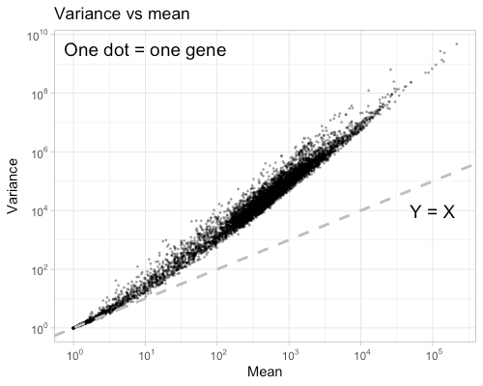
Distribution of counts data
If X_{G} ~ Poisson(Nπ_{G}):
mean(X_{G}) = variance(X_{G}) = Nπ_{G}
Due to biological variability, we observe over-dispersion:
→ Need a statistical law with variance ≠ mean.

Slide 45
Distribution of counts data
Let x_{ij} the number of reads that align on gene i for sample j (intersection row i - column j of the count matrix).
x_{ij} ∼ Negative-Binomial(mean = μ_{ij}, variance = σ_{ij}²)
where:
σ_{ij}² = μ_{ij} + φ_{i} μ_{ij}²
φ_{i} : biological dispersion of gene i
Particularity:
the x_{ij}’s are null or positive integers.

Slide 46
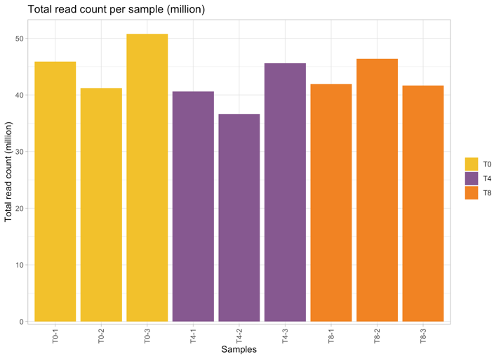
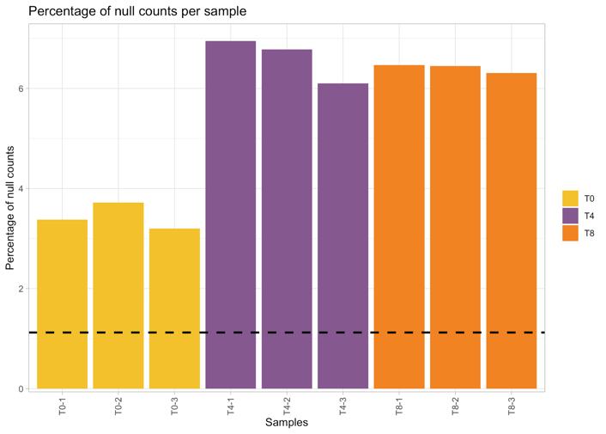
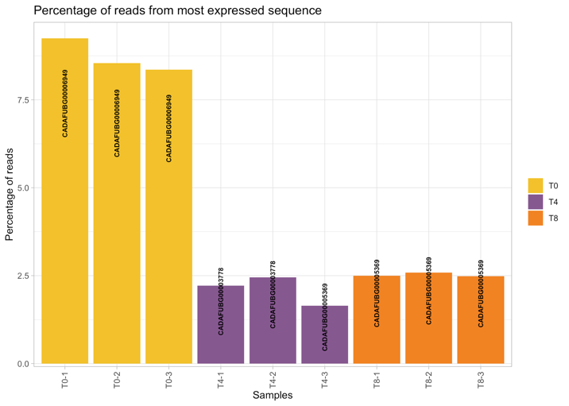
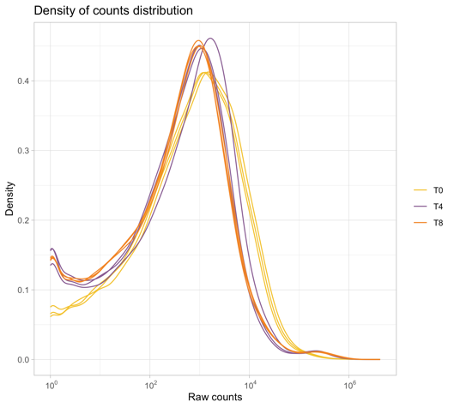
Descriptions sample by sample

Slide 47
SERE coefficient [2]
Simple Error Ratio Estimate
Goal: assess the similarity/dissimilarity between samples
SERE(A, B)
More suited to RNA-Seq data than the Pearson/Spearman correlation coefficients.
= 0 if A = B
≈ 1 if A and B are technical replicates
> 1 if A and B are biological replicates
>> 1 if A and B come from different bio. conditions

Slide 48
SERE coefficient: details
2 samples (A and B) and N genes under study
y_{ij} = # of reads for gene i (1, …, N) and sample j (A or B)
L_{j} = total # of reads (library size) for sample j
E_{i} = y_{iA} + y_{iB} = number of reads for gene i
Expected # of reads for gene i and sample j:
ŷ_{ij} = E_{i} x L_{j} / (L_{A} + L_{B})
Expected variation for each observation y_{ij} : (y_{ij} – ŷ_{ij})²
Expected variation under Poisson assumption: ŷ_{ij}
Overdispersion for each gene i: s_{i}² = (y_{iA} – ŷ_{iA})²/ŷ_{iA} + (y_{iB} – ŷ_{iB})²/ŷ_{iB}
SERE(A, B) = sqrt((Σ_{i=1..N} s_{i}²) / N)

Slide 49
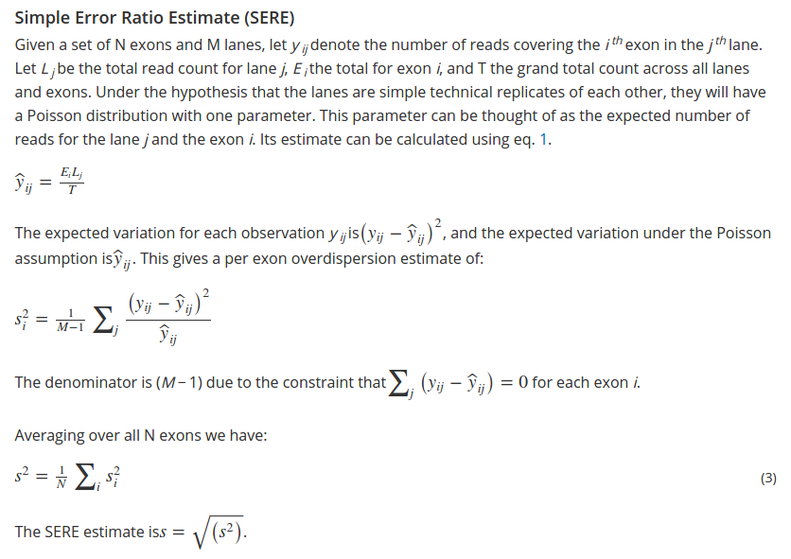
SERE coefficient: details

Slide 50
SERE coefficient: example
Drawback: not very easy to interpret with many samples.
 | T0-1 | T0-2 | T0-3 | T4-1 | T4-2 | T4-3 | T8-1 | T8-2 | T8-3
T0-1 | 0 | 2.97 | 3.88 | 73.89 | 71.83 | 74.02 | 74.69 | 76.90 | 74.03
T0-2 | 2.97 | 0 | 3.00 | 72.21 | 70.03 | 72.33 | 72.94 | 75.15 | 72.32
T0-3 | 3.88 | 3.00 | 0 | 76.34 | 74.28 | 76.33 | 77.18 | 79.38 | 76.51
T4-1 | 73.89 | 72.21 | 76.34 | 0 | 5.83 | 10.42 | 17.27 | 14.93 | 17.99
T4-2 | 71.83 | 70.03 | 74.28 | 5.83 | 0 | 10.89 | 17.77 | 15.07 | 18.10
T4-3 | 74.02 | 72.33 | 76.33 | 10.42 | 10.89 | 0 | 19.86 | 18.25 | 20.07
T8-1 | 74.69 | 72.94 | 77.18 | 17.27 | 17.77 | 19.86 | 0 | 6.72 | 4.04
T8-2 | 76.90 | 75.15 | 79.38 | 14.93 | 15.07 | 18.25 | 6.72 | 0 | 8.22
T8-3 | 74.03 | 72.32 | 76.51 | 17.99 | 18.10 | 20.07 | 4.04 | 8.22 | 0

Slide 51
Exploratory data analysis (EDA)
Two main tools:
Principal Component Analysis (PCA)
Clustering
Pre-requisite:
Notion of distance between the samples
Make the data homoscedastic
variance must be independent of the mean

Slide 52
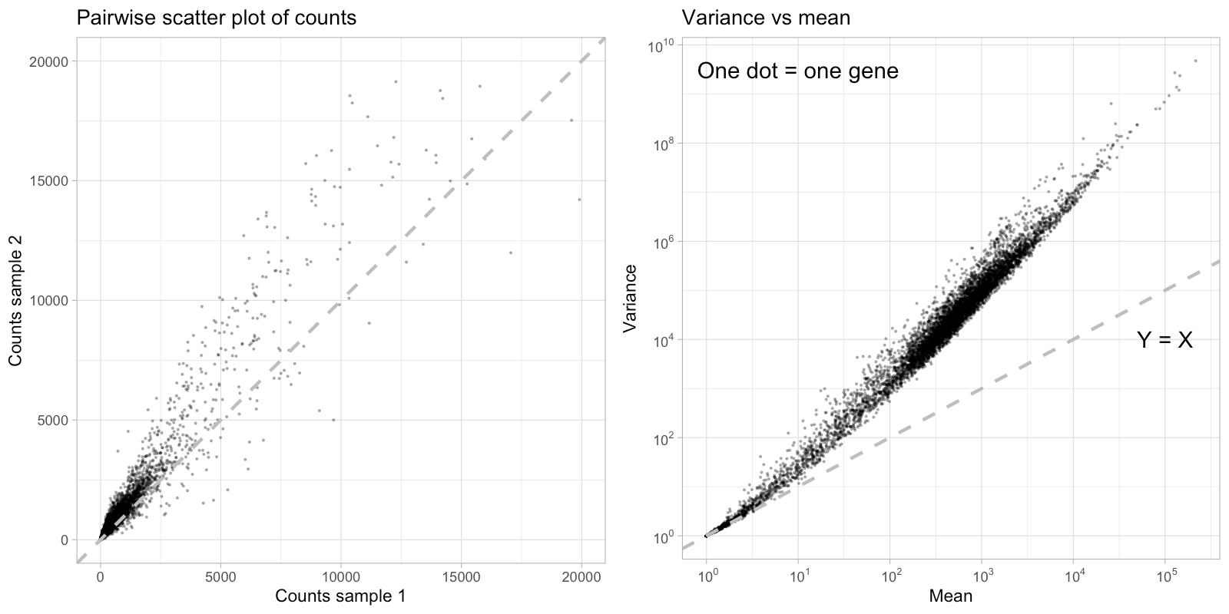
Variance increases with intensity

Slide 53
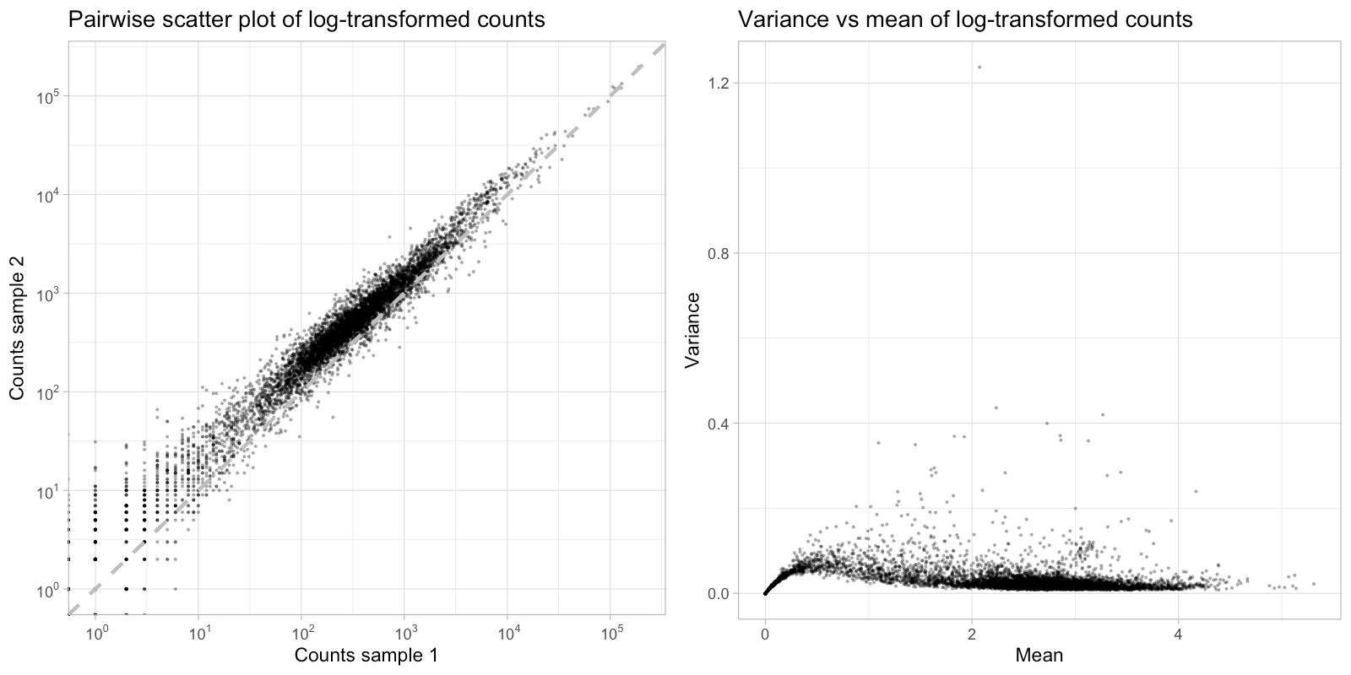
Log-transformation

Slide 54
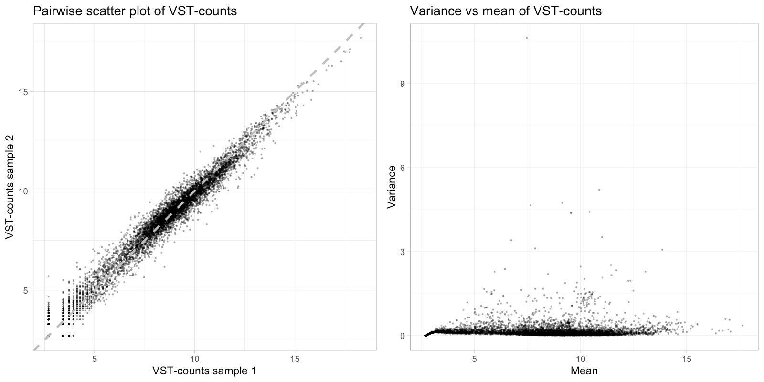
Variance-Stabilizing Transformation [3]
Use these data to perform Exploratory Data Analysis!
Use these data to perform Exploratory Data Analysis ONLY !

Slide 55
Principal Component Analysis (PCA)
Goal:
Facilitate the vision of a large (high dimensional) data set.
Method:
Project a cloud of P dots (samples) of dimension N (genes) on a subspace (e.g. a line or a plan) while conserving most of its structure.

Slide 56
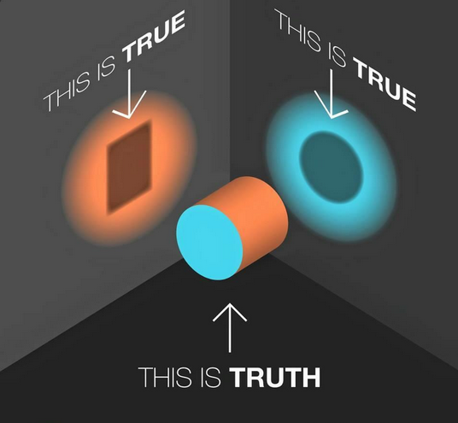
Projection: loss of information

Slide 57
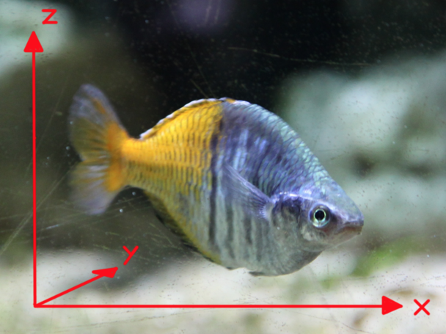
PCA on a fish (source: bioinfo-fr.net)

Slide 58
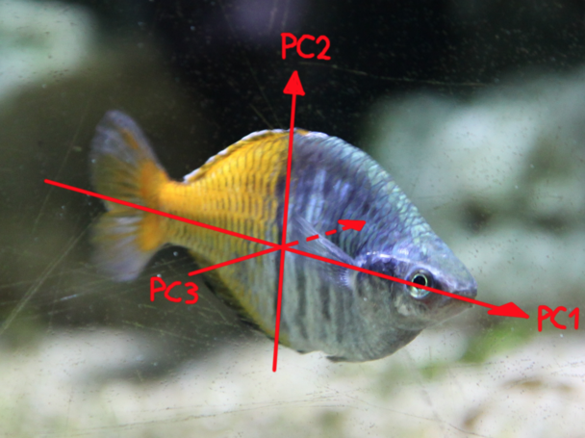
PCA on a fish (source: bioinfo-fr.net)

Slide 59
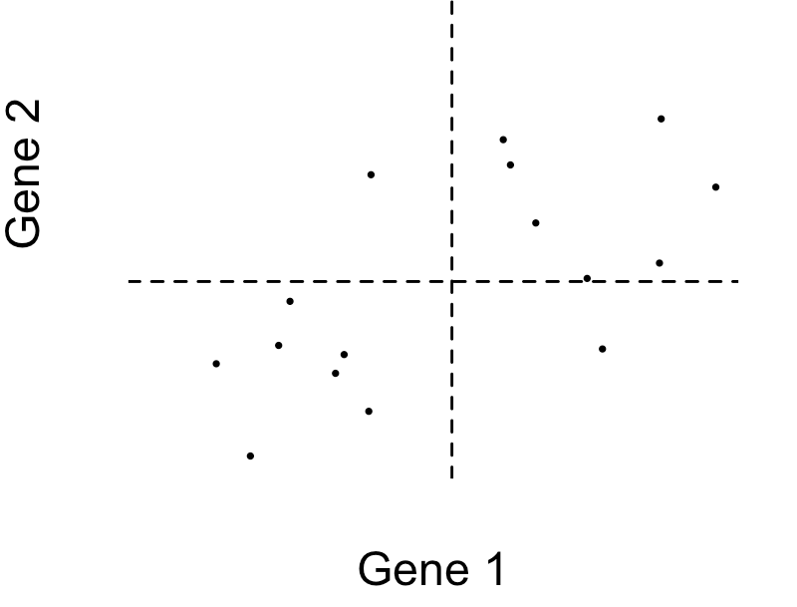
PCA of a small cloud (2 dimensions)
One dot = one sample

Slide 60
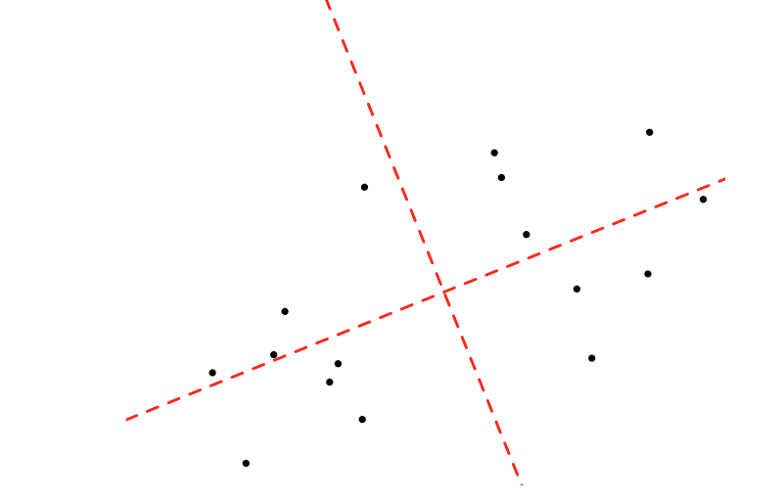
PCA of a small cloud (2 dimensions)
PC₁ = z¹₁ Gene₁ + z¹₂ Gene₂
PC₂ = z²₁ Gene₁ + z²₂ Gene₂
PC 2
One dot = one sample
PC 1

Slide 61
PCA: important scores
Percentage of inertia associated with an axis:
Proportion of the total information supported by this axis
Decreases with the axis rank (by construction)
Number of axes to interpret:
Such as the sum of the percentages of inertia is ≥ x%
Elbow criterion
And many other methods
Comment: the data structure is (supposed to be) known in a differential analysis framework.

Slide 62
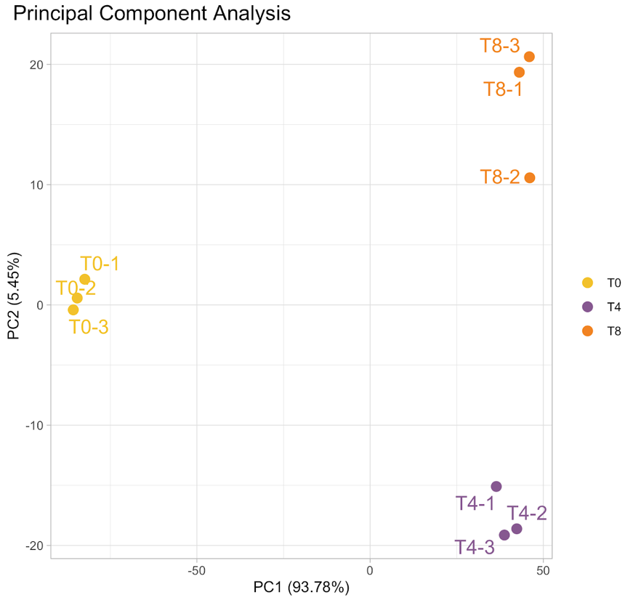
PCA: RNA-Seq example
Pre-requisite: counts must be transformed (made homoscedastic) before building the PCA.

Slide 63
PCA: dimensionality reduction
 | T0-1 | T0-2 | T0-3 | T4-1 | T4-2 | T4-3 | T8-1 | T8-2 | T8-3
gene1 | 6.41 | 6.35 | 6.47 | 5.36 | 5.54 | 5.38 | 5.03 | 5.41 | 4.96
gene2 | 7.07 | 7.10 | 7.02 | 9.21 | 9.24 | 9.05 | 7.69 | 8.19 | 7.77
gene3 | 6.21 | 6.24 | 6.12 | 3.71 | 4.06 | 4.32 | 3.93 | 4.05 | 3.91
gene4 | 7.35 | 7.34 | 7.44 | 6.51 | 6.12 | 6.44 | 6.71 | 6.47 | 6.50
gene5 | 1.04 | 1.24 | 0.62 | 0.16 | 0.17 | 0.50 | 1.02 | 0.97 | 1.26
gene6 | 0.69 | 0.04 | 0.36 | 0.12 | 0.67 | 0.80 | 2.02 | 1.28 | 1.32
gene7 | 0.24 | 0.69 | -0.01 | -0.76 | -0.74 | -0.79 | -0.72 | -0.74 | -0.72
... | 3.29 | 3.76 | 3.18 | 4.74 | 3.98 | 3.47 | 4.31 | 4.95 | 4.65
geneN | 3.65 | 4.17 | 4.13 | 5.96 | 6.17 | 5.65 | 4.09 | 4.02 | 3.98
From genes/variables to principal components
PC1 | -60.1 | -61.0 | -61.5 | 25.9 | 30.4 | 28.8 | 31.0 | 33.1 | 33.3
PC2 | 1.3 | 0.5 | -0.1 | -11.9 | -14.0 | -15.0 | 15.1 | 7.9 | 16.3
PC3 | 0.4 | 0.3 | 0.1 | -0.1 | -0.2 | -0.3 | 0.1 | 0 | -0.1
PC4 | -0.2 | 0 | -0.1 | 0.1 | 0.1 | 0.2 | -0.1 | -0.2 | 0.2

Slide 64
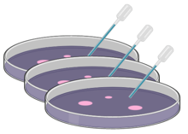
PCA: confounding effect
Transcriptome study of a bacteria at 0h, 2h, 16h and 24h:
r1
r2
r3
r1
r2
r3
0h 2h 4h 8h 16h 24h
label | time | replicate | date | libraries_method | libraries_exp | libraries_date
0h-1 | 0h | r1 | oct18 | robot | Bob | nov18
0h-2 | 0h | r2 | oct18 | robot | Bob | nov18
0h-3 | 0h | r3 | oct18 | robot | Bob | nov18
2h-1 | 2h | r1 | oct18 | robot | Bob | nov18
2h-2 | 2h | r2 | oct18 | robot | Bob | nov18
2h-3 | 2h | r3 | oct18 | robot | Bob | nov18
16h-1 | 16h | r1 | oct18 | robot | Bob | nov18
16h-2 | 16h | r2 | oct18 | robot | Bob | nov18
16h-3 | 16h | r3 | oct18 | robot | Bob | nov18
24h-1 | 24h | r1 | oct18 | robot | Bob | nov18
24h-2 | 24h | r2 | oct18 | robot | Bob | nov18
24h-3 | 24h | r3 | oct18 | robot | Bob | nov18

Slide 65
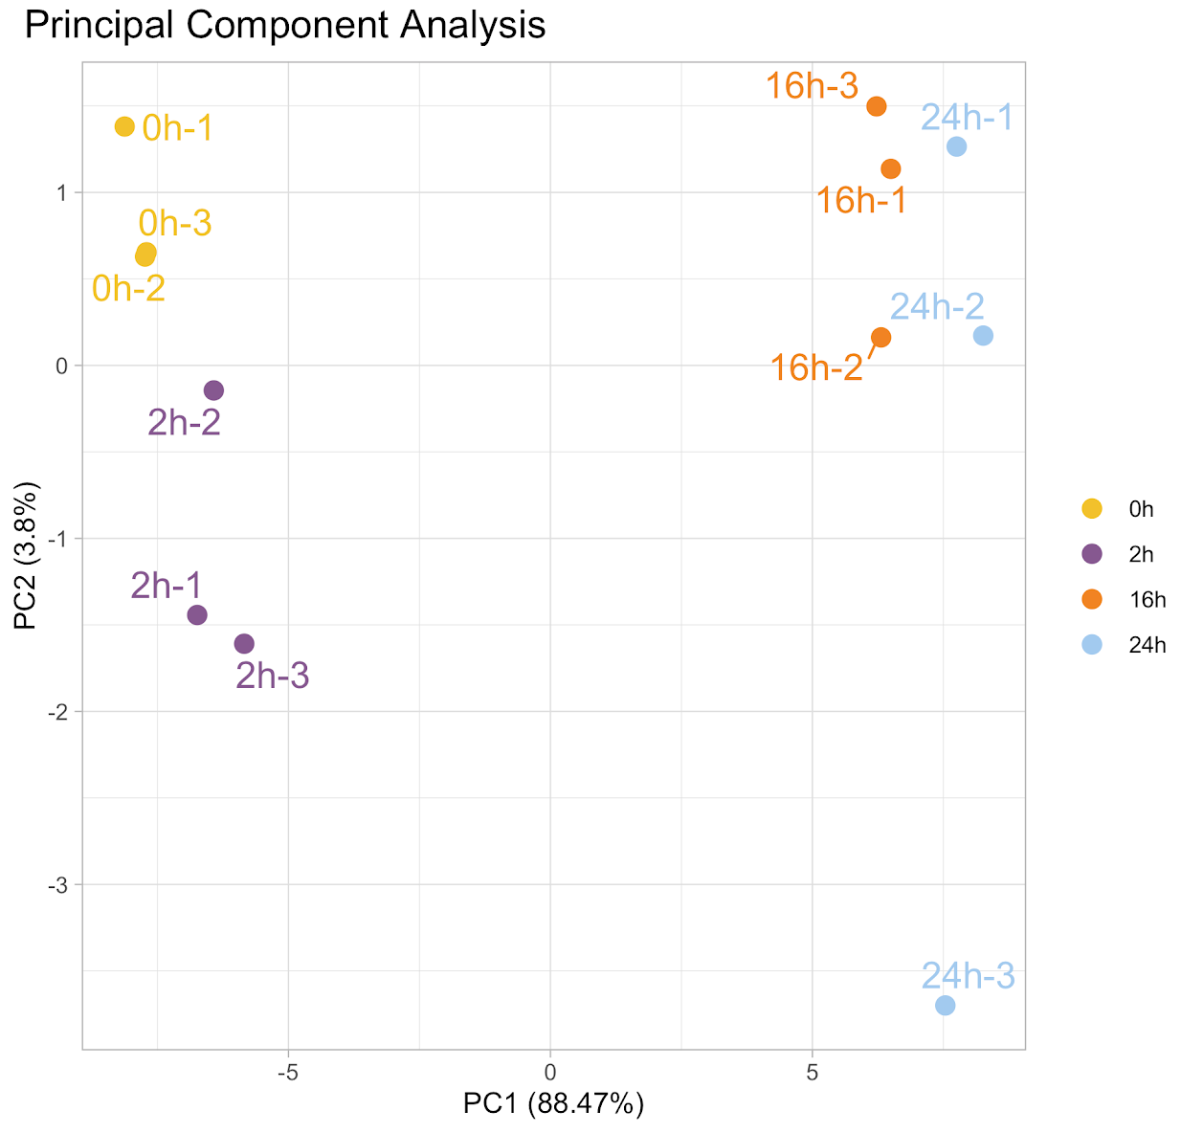
PCA: confounding effect
Transcriptome study of a bacteria at 0h, 2h, 16h and 24h:

Slide 66
PCA: confounding effect
Add samples 4h and 8h from the same cultures:
r1
r2
r3
r1
r2
r3
0h 2h 4h 8h 16h 24h
label | time | replicate | date | libraries_method | libraries_exp | libraries_date
0h-1 | 0h | r1 | oct18 | robot | Bob | nov18
0h-2 | 0h | r2 | oct18 | robot | Bob | nov18
0h-3 | 0h | r3 | oct18 | robot | Bob | nov18
2h-1 | 2h | r1 | oct18 | robot | Bob | nov18
2h-2 | 2h | r2 | oct18 | robot | Bob | nov18
2h-3 | 2h | r3 | oct18 | robot | Bob | nov18
4h-1 | 4h | r1 | oct18 | manual | Donald | jun19
4h-2 | 4h | r2 | oct18 | manual | Donald | jun19
4h-3 | 4h | r3 | oct18 | manual | Donald | jun19
8h-1 | 8h | r1 | oct18 | manual | Donald | jun19
8h-2 | 8h | r2 | oct18 | manual | Donald | jun19
8h-3 | 8h | r3 | oct18 | manual | Donald | jun19
16h-1 | 16h | r1 | oct18 | robot | Bob | nov18
16h-2 | 16h | r2 | oct18 | robot | Bob | nov18
16h-3 | 16h | r3 | oct18 | robot | Bob | nov18
24h-1 | 24h | r1 | oct18 | robot | Bob | nov18
24h-2 | 24h | r2 | oct18 | robot | Bob | nov18
24h-3 | 24h | r3 | oct18 | robot | Bob | nov18

Slide 67

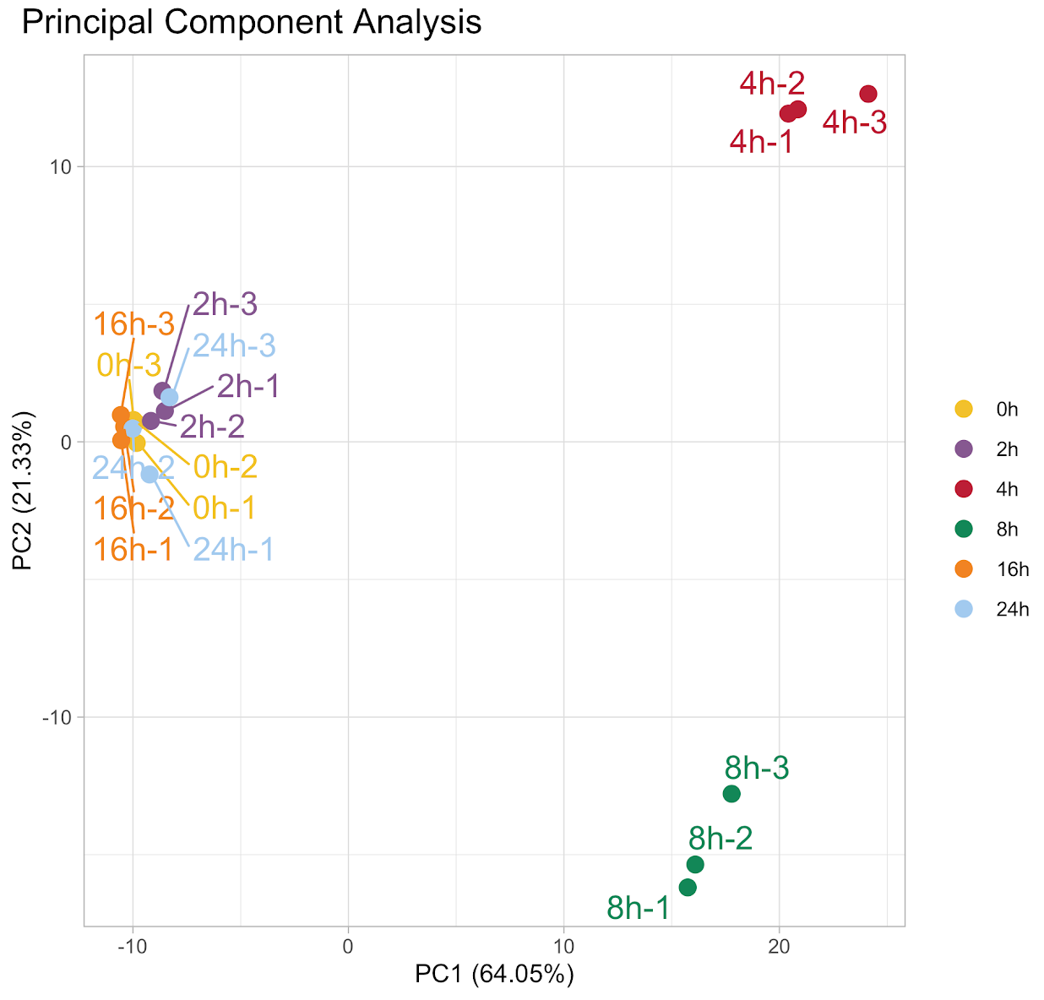
PCA: confounding effect
Global analysis of times 0h, 2h, 4h, 8h, 16h and 24h:
$
1st sequencing batch
2nd sequencing batch

Slide 68
PCA: pairing factor
Two treatments applied to human cells coming from 3 donors:
label | treatment | donor
d1-IFN | IFN | d1
d1-Ctrl | Ctrl | d1
d2-IFN | IFN | d2
d2-Ctrl | Ctrl | d2
d3-IFN | IFN | d3
d3-Ctrl | Ctrl | d3

Slide 69
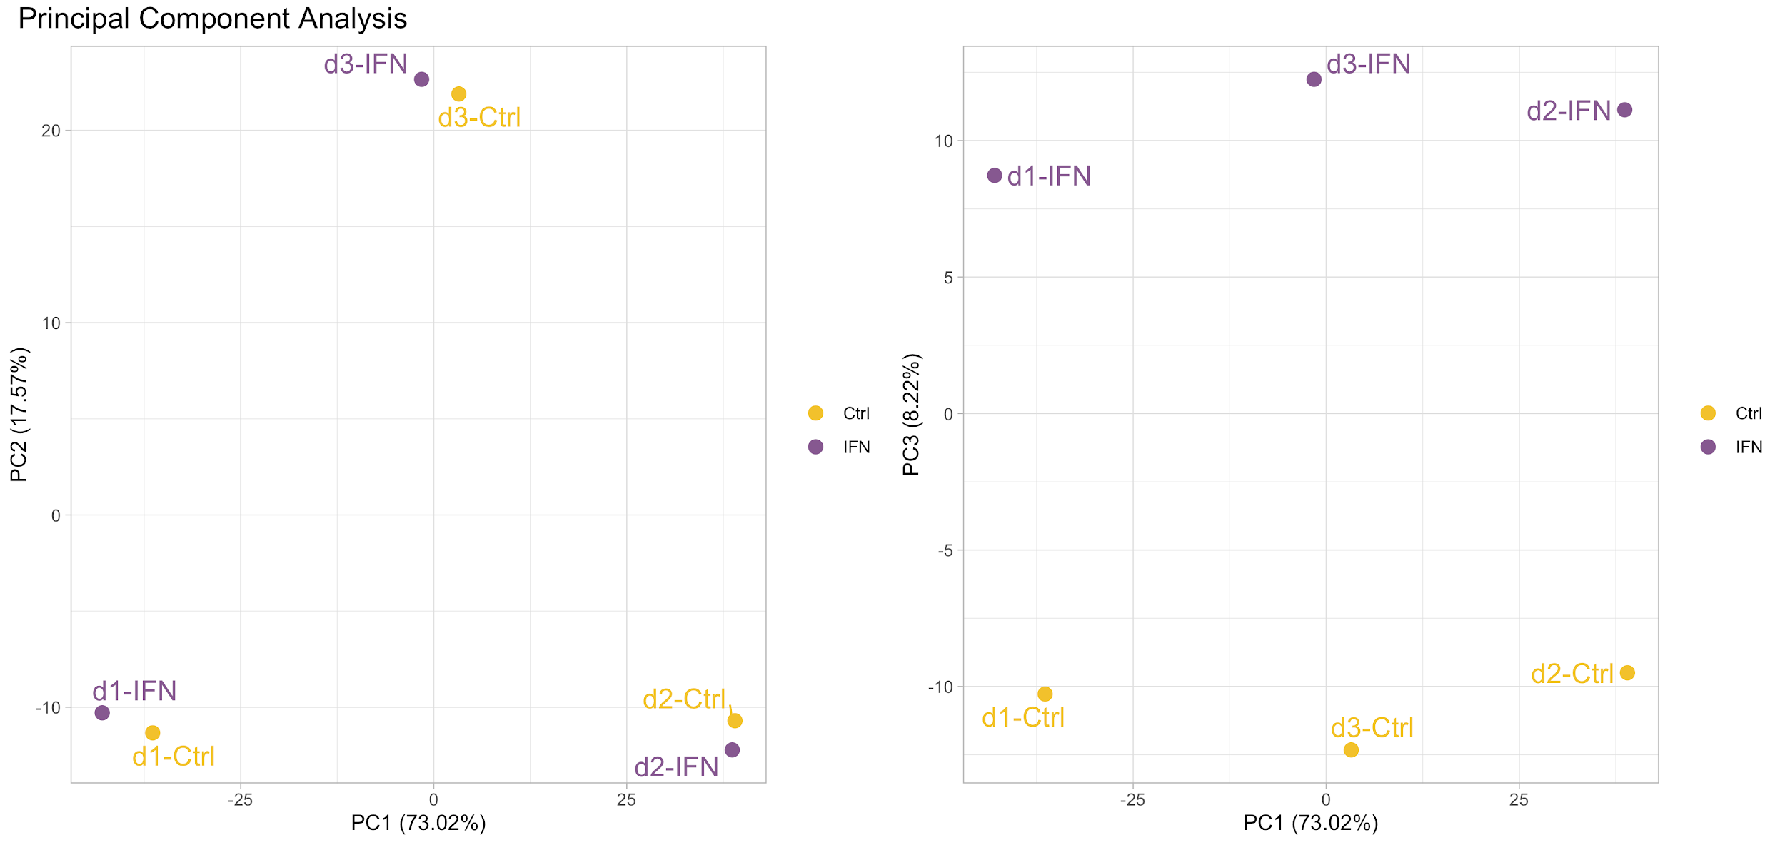

PCA: pairing factor
Two treatments applied to human cells coming from 3 donors:

Slide 70
PCA: pairing factor
Two treatments applied to human cells coming from 3 donors:

Slide 71
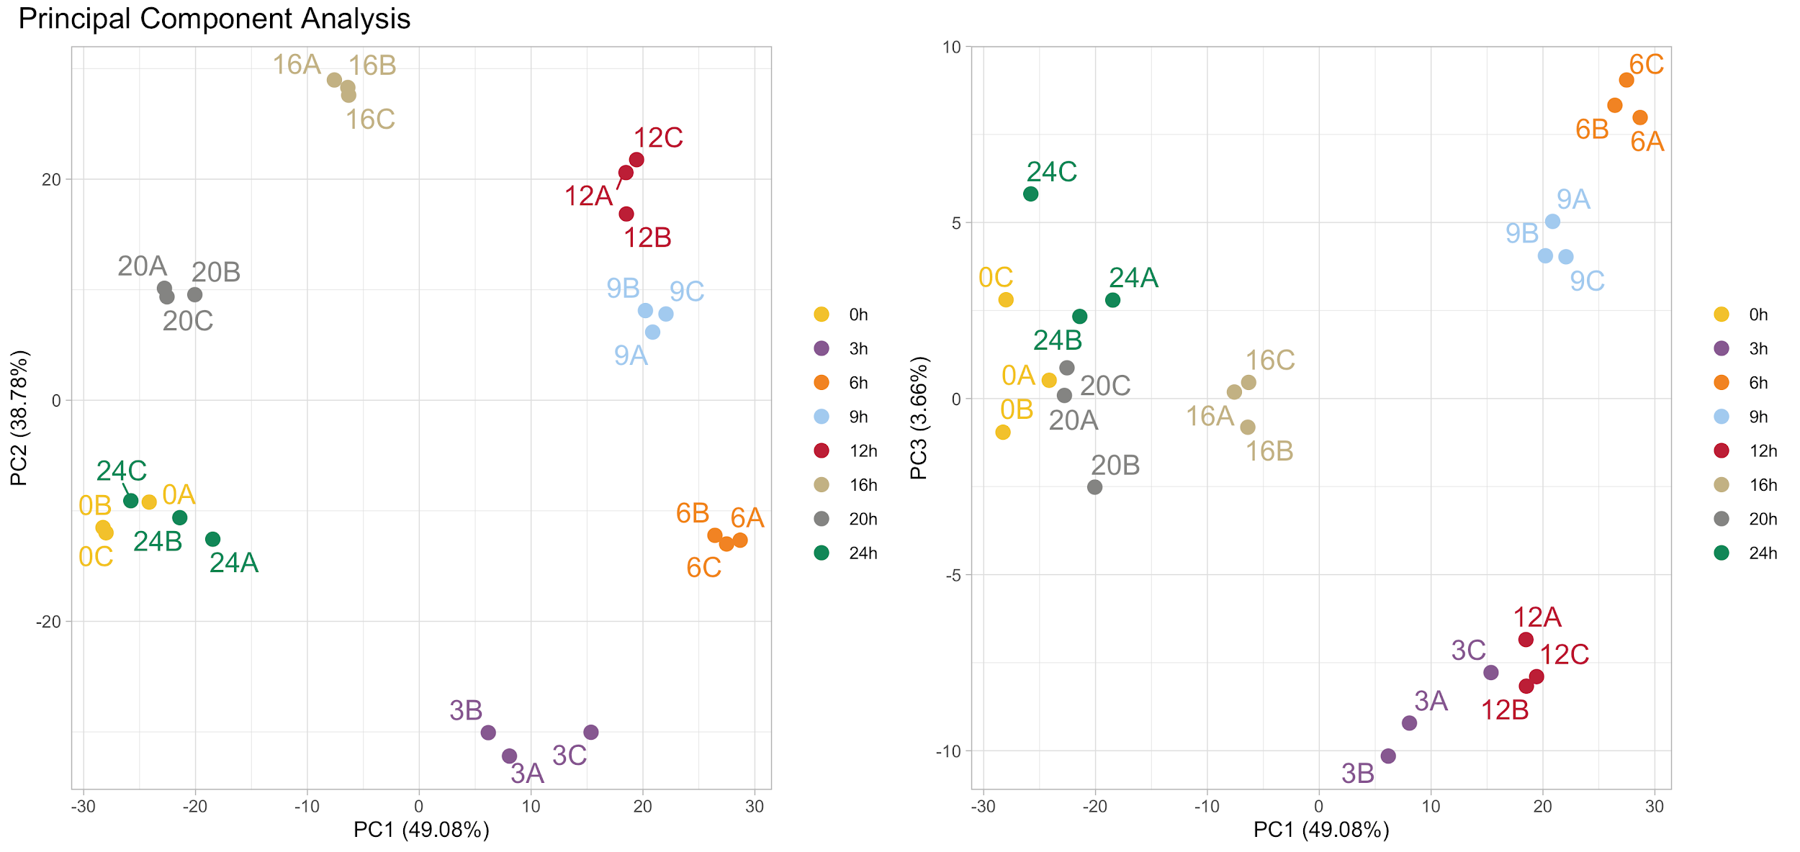
PCA: most beautiful RNA-Seq example
Transcriptome study of a cyanobacteria at 8 time points from 0h to 24h:

Slide 72
Clustering
Goal: build groups of samples such that:
samples within a group are similar
samples from distinct groups are different
Method (ascendant clustering):
Calculate the distances between each pair of samples
Gather the two nearest samples into a cluster
Calculate the distance between this cluster and each sample
Gather the two nearest clusters/samples
Go back to step 3 until getting a single cluster

Slide 73
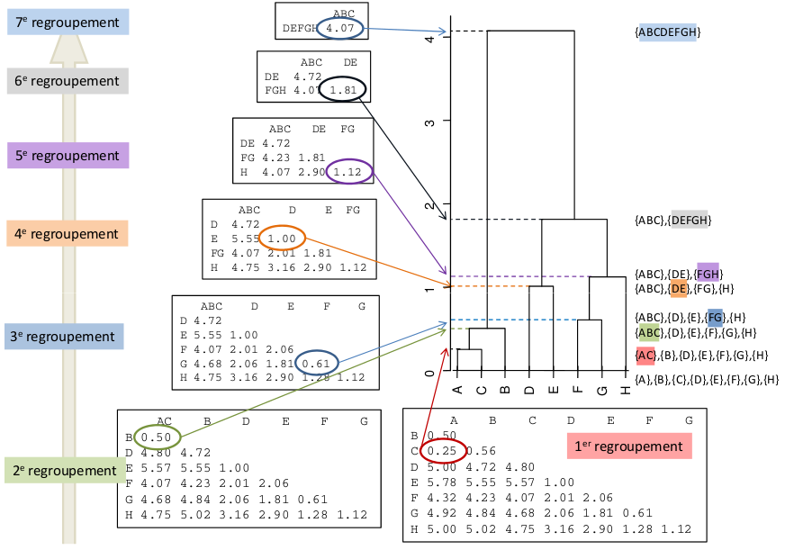
Hierarchical clustering: example
Source: MOOC FUN Analyse de données 2015 – Agrocampus Ouest

Slide 74
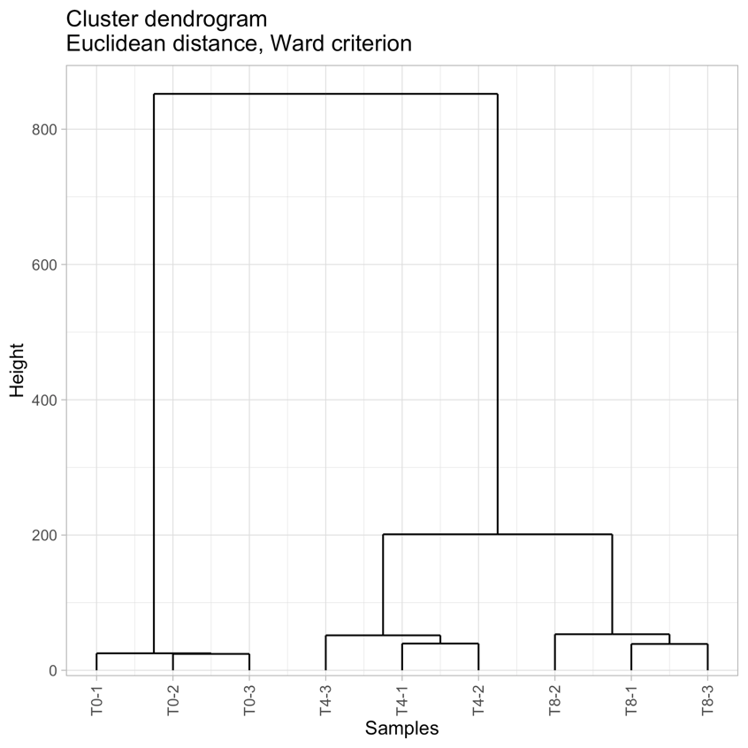
Hierarchical clustering: RNA-Seq example
Pre-requisite: counts must be transformed (made homoscedastic) before building the PCA.

Slide 75

Clustering parameters
Distance between two samples: euclidean, correlation, Manhattan, SERE ...
Aggregation criterion (i.e. distance between two clusters):
Average linkage: average distance between all the samples
Single linkage: distance between the two closest samples
Complete linkage: distance between the two furthest samples
Ward: merge the clusters that lead to the cluster with minimum variance
?

Slide 76
Data exploration : Take-home message
Always visualize your data first !
To detect early on potential problems in the design
To guide you through the next steps of the analysis
To provide some biological interpretation
To communicate your results
Don’t overlook potential breach of hypothesis for the analysis methods, or choices of parameters

Slide 77
Outline
Introduction
Designing the experiment
Description/exploration
Normalization
Modeling
SARTools

Slide 78

Goal
Identify and correct for systematic technical bias and make the counts comparable between samples.

Slide 79
Framework
Normalization framework:
RNA-seq data
Differential expression experiment
Counts data (positive integer values)
Total number of reads (library size): number of reads sequenced, mapped and counted for a given sample (sum over the rows for a given column of the count matrix).

Slide 80
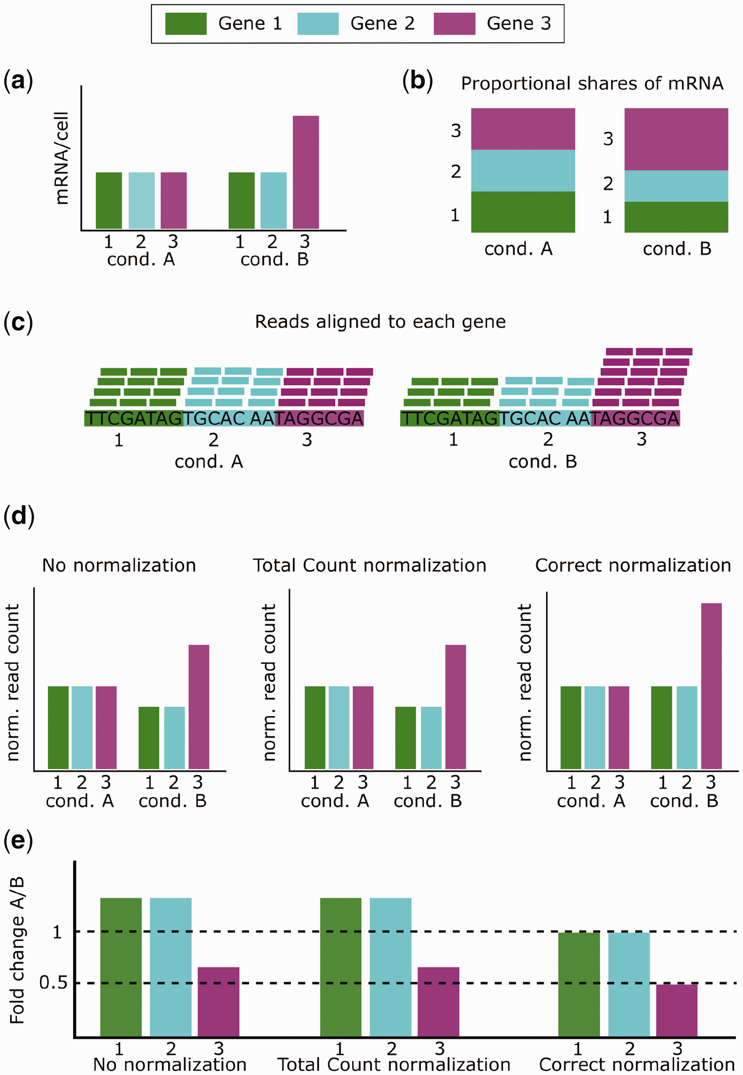
What is a differentially expressed gene? [10]
C. Evans et al. Selecting between-sample RNA-Seq normalization methods from the perspective of their assumptions. Briefings in Bioinformatics, 2017.

Slide 81
What is a differentially expressed gene? [10]
C. Evans et al. Selecting between-sample RNA-Seq normalization methods from the perspective of their assumptions. Briefings in Bioinformatics, 2017.

Slide 82
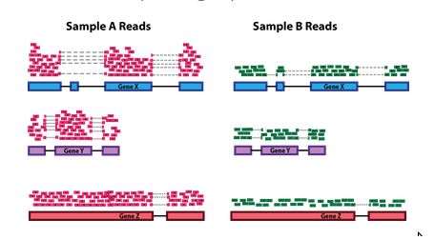
Goal of the DESeq2/edgeR normalizations
1. Correct for the differences of library sizes:
2. Correct for the differences of library compositions:
 | Sample 1 | Sample 2
gene1 | 30 | 60
gene2 | 50 | 100
gene3 | 20 | 40
gene4 | 100 | 200
Total | 200 | 400
 | Sample 1 | Sample 2
gene1 | 30 | 60
gene2 | 50 | 100
gene3 | 20 | 40
gene4 | 100 | 0
Total | 200 | 200

Slide 83
DESeq2 normalization: computation of s₁
DESeq2 computes a size factor per sample:
Step 1 : Creating a pseudo-reference sample (row-wise geometric mean)
 | T0-1 | T0-5 | ... | T8-3
gene1 | 151 | 131 | ... | 18
gene2 | 142 | 134 | ... | 151
gene3 | 157 | 147 | ... | 8
gene4 | 275 | 249 | ... | 62
gene5 | 4 | 5 | ... | 3
gene6 | 2 | 0 | ... | 3
gene7 | 4 | 7 | ... | 0
gene8 | 10 | 16 | ... | 23
gene9 | 12 | 20 | ... | 9
gene10 | 269 | 262 | ... | 48
... | ... | ... | ... | ...
geneN | 18 | 31 | ... | 2

Slide 84
DESeq2 normalization: computation of s₁
DESeq2 computes a size factor per sample:
Step 1 : Creating a pseudo-reference sample (row-wise geometric mean)
pseudo-ref
 | T0-1 | T0-5 | ... | T8-3
gene1 | 151 | 131 | ... | 18 | 31
gene2 | 142 | 134 | ... | 151
gene3 | 157 | 147 | ... | 8
gene4 | 275 | 249 | ... | 62
gene5 | 4 | 5 | ... | 3
gene6 | 2 | 0 | ... | 3
gene7 | 4 | 7 | ... | 0
gene8 | 10 | 16 | ... | 23
gene9 | 12 | 20 | ... | 9
gene10 | 269 | 262 | ... | 48
... | ... | ... | ... | ...
geneN | 18 | 31 | ... | 2
1/n
( )
x
x
x
Notes:
In mathematics, the geometric mean is a mean or average which indicates a central tendency of a finite set of real numbers by using the product of their values (as opposed to the arithmetic mean which uses their sum). The geometric mean is defined as the nth root of the product of n numbers, i.e., for a set of numbers a₁, a₂, ..., a_{n}, the geometric mean is defined as

Slide 85
DESeq2 normalization: computation of s₁
DESeq2 computes a size factor per sample:
Step 1 : Creating a pseudo-reference sample (row-wise geometric mean)
pseudo-ref
 | T0-1 | T0-5 | ... | T8-3
gene1 | 151 | 131 | ... | 18 | 31
gene2 | 142 | 134 | ... | 151 | 650
gene3 | 157 | 147 | ... | 8 | 7
gene4 | 275 | 249 | ... | 62 | 70
gene5 | 4 | 5 | ... | 3 | 2
gene6 | 2 | 0 | ... | 3 | 1
gene7 | 4 | 7 | ... | 0 | 5
gene8 | 10 | 16 | ... | 23 | 28
gene9 | 12 | 20 | ... | 9 | 74
gene10 | 269 | 262 | ... | 48 | 112
... | ... | ... | ... | ... | ...
geneN | 18 | 31 | ... | 2 | 4

Slide 86
DESeq2 normalization: computation of s₁
DESeq2 computes a size factor per sample:
Step 2 : Comparing each sample to pseudo-reference (ratio)
pseudo-ref
T0-1 / ref
 | T0-1 | T0-5 | ... | T8-3
gene1 | 151 | 131 | ... | 18 | 31 | 4.87
gene2 | 142 | 134 | ... | 151 | 650 | 0.22
gene3 | 157 | 147 | ... | 8 | 7 | 22.43
gene4 | 275 | 249 | ... | 62 | 70 | 3.93
gene5 | 4 | 5 | ... | 3 | 2 | 2.00
gene6 | 2 | 0 | ... | 3 | 1 | 2.00
gene7 | 4 | 7 | ... | 0 | 5 | 0.80
gene8 | 10 | 16 | ... | 23 | 28 | 0.36
gene9 | 12 | 20 | ... | 9 | 74 | 0.16
gene10 | 269 | 262 | ... | 48 | 112 | 2.40
... | ... | ... | ... | ... | ... | ...
geneN | 18 | 31 | ... | 2 | 4 | 4.87

Slide 87
DESeq2 normalization: computation of s₁
DESeq2 computes a size factor per sample:
Step 3 : Final size factor (median)
pseudo-ref
T0-1 / ref
 | T0-1 | T0-5 | ... | T8-3
gene1 | 151 | 131 | ... | 18 | 31 | 4.87
gene2 | 142 | 134 | ... | 151 | 650 | 0.22
gene3 | 157 | 147 | ... | 8 | 7 | 22.43
gene4 | 275 | 249 | ... | 62 | 70 | 3.93
gene5 | 4 | 5 | ... | 3 | 2 | 2.00
gene6 | 2 | 0 | ... | 3 | 1 | 2.00
gene7 | 4 | 7 | ... | 0 | 5 | 0.80
gene8 | 10 | 16 | ... | 23 | 28 | 0.36
gene9 | 12 | 20 | ... | 9 | 74 | 0.16
gene10 | 269 | 262 | ... | 48 | 112 | 2.40
... | ... | ... | ... | ... | ... | ...
geneN | 18 | 31 | ... | 2 | 4 | 4.87
s₁ = median

Slide 88
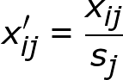
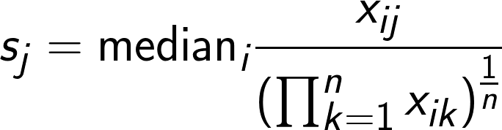

DESeq2 normalization: computation of s₁
Step 1 : geometric mean of each gene
Step 2 : ratio between sample and reference
Normalized count :
 | T0-1 | T0-5 | ... | T8-3
gene1 | 151 | 131 | ... | 18 | 31 | 4.87
gene2 | 142 | 134 | ... | 151 | 650 | 0.22
gene3 | 157 | 147 | ... | 8 | 7 | 22.43
gene4 | 275 | 249 | ... | 62 | 70 | 3.93
gene5 | 4 | 5 | ... | 3 | 2 | 2.00
gene6 | 2 | 0 | ... | 3 | 1 | 2.00
gene7 | 4 | 7 | ... | 0 | 5 | 0.80
gene8 | 10 | 16 | ... | 23 | 28 | 0.36
gene9 | 12 | 20 | ... | 9 | 74 | 0.16
gene10 | 269 | 262 | ... | 48 | 112 | 2.40
... | ... | ... | ... | ... | ... | ...
geneN | 18 | 31 | ... | 2 | 4 | 4.87
Step 3 : median
s₁ = median

Slide 89
DESeq2 normalization [3]
Size factor s_{j} per sample:
Normalized counts:
Assumptions:
The majority of the genes is not differentially expressed
As many down- as up-regulated genes
x_{ij}: number of reads for gene i in sample j
n: number of samples studied
s_{j} : normalization factor for sample j

Slide 90


edgeR normalization [4]
edgeR computes a normalization factor
f_{j} per sample and normalizes the total
numbers of reads N_{j}:
We can calculate DESeq2-like size factors s_{j} in order to normalize the counts:
and so
Assumptions: same than DESeq2.
x_{ij}: number of reads for gene i in sample j
N_{j}: total number of reads in sample j (lib size)
n: number of samples studied
s_{j} or f_{j}: normalization factor for sample j
L_{i}: length of gene i

Slide 91



Other normalization methods
Total number of reads:
or
Robustness issue if a gene catches a very high number of reads.
RPKM (Reads Per Kilobase per Million mapped reads):
Same issue than the total number of reads method
Introduce other biases [5]
No need to correct for the gene length since the gene is "fixed"

Slide 92

Effect of the normalization (DESeq2 or edgeR)

Slide 93
Outline
Introduction
Designing the experiment
Description/exploration
Normalization
Modeling
SARTools

Slide 94
Classic linear model
Goal:
Explain a dependent variable Y thanks to a set a explicative variables
X = (X₁ , ..., X_{n}) using the model:
Y ∼ Xβ + ε
Output of the model:
Estimations of β₁, ..., β_{n}: effect of each explicative variable on Y.

Slide 95

Linear model: RNA-Seq example
Goal: explain counts of gene g thanks to the biological conditions.

Slide 96

Linear model: RNA-Seq example
Goal: explain counts of gene g thanks to the bio. conditions (T0, T4 and T8).
Here: β_{0g} = 5.95, β_{1g} = 2.91 and β_{2g} = 3.57
One model per gene → thousands of models!
^
^
^

Slide 97
Statistical testing
Biological question:
Is gene g differentially expressed between green and gray mice?
 | Green1 | Green2 | Green3 | Gray1 | Gray2 | Gray3
Gene g | 151 | 131 | 183 | 135 | 184 | 122

Slide 98
Statistical testing
Biological question:
Is gene g differentially expressed between green and gray mice?
Statistical formalization
Let μ₁ the average expression of gene g for gray mice and μ₂ the expression of green mice. We wish to test the hypotheses:
H₀: μ₁ = μ₂ vs. H₁: μ₁ ≠ μ₂
 | Green1 | Green2 | Green3 | Gray1 | Gray2 | Gray3
Gene g | 151 | 131 | 183 | 135 | 184 | 122
How to decide ?

Slide 99

Type I error rate: α
Framework and goal:
We wish to show that the expression of gene g of gray mice is different from the expression of green mice.
Which risk α of being wrong do we allow when saying :
“gene g is differentially expressed?”
The risk α is chosen before the analysis

Slide 100

Type II error rate: β
We assume that gene g is truly differentially expressed between gray and green mice.
Which risk β of not discovering gene g do we allow?
Which power 1 − β do we want?
We can theoretically control the risk β according to the risk α and the number of replicates.

Slide 101



Type I and type II errors
Hotdog classification
Type I error
Type II error

Slide 102
Formalization
Let μ₁ the average expression of gene g for gray mice and μ₂ the expression of green mice. We wish to test the hypotheses:
H₀: μ₁ = μ₂ vs. H₁: μ₁ ≠ μ₂
The risks can be summarized in:
Decision
 | Do not reject H₀ | Reject H₀
H₀ true | 1 - α | α
H₀ false | β | 1 - β
Unknown truth
TP
FN
FP
TN

Slide 103



Statistical Power
power
power increases with sample size
and with effect size !

Slide 104
p-value and conclusion of the test
Definition:
Conclusion:
if p-value ≤ α then we reject H₀
p-value | = Proba(reject H₀ | H₀ true)
 | = Proba(doing a mistake when rejecting H₀)
 | = Proba(observed difference is due to hazard)
With a risk α, we can conclude that there is a significant difference in gene g expression between green and gray mice

Slide 105
Equal Fold-Changes – different p-values
Reminder: Fold-Change definition:
FC = =
expression condition “green”
expression condition “gray”
µ₂
µ₁
Gene | m1 | m2 | m3 | m4 | m5 | m6 | FC | p-value
gene1 | 5 | 7 | 6 | 2 | 2 | 2 | 3 | 0.06
gene2 | 800 | 1000 | 900 | 350 | 250 | 200 | 3 | 0.03
gene3 | 700 | 900 | 1100 | 350 | 200 | 250 | 3 | 0.10
gene4 | 900 | 500 | 1300 | 200 | 550 | 50 | 3 | 0.06
... | ... | ... | ... | ... | ... | ... | ... | ...

Slide 106

Distribution of raw p-values

Slide 107

Distribution of raw p-values

Slide 108
Omics data: multiple testing issue
Context:
We perform a large number N of statistical tests for which we reject or not H₀.
Possible conclusions:
Among all the genes told differentially expressed, the False Discovery Rate (FDR) is:
Decisions
 | Non rejects of H₀ | Rejects of H₀
H₀ true | TN | FP
H₀ false | FN | TP
Unknown truths
FP
FP + TP

Slide 109
Example of the multiple testing issue
We perform N = 10000 statistical tests and we get the following conclusions:
= = 36% of falsely discovered genes!
 | Non rejects of H₀ | Rejects of H₀ | Total
H₀ true | 8550 | 450 | 9000
H₀ false | 200 | 800 | 1000
Total | 8750 | 1250 | 10000
FP
FP + TP
450
450 + 800

Slide 110

Control of the FDR
Goal: control the FDR among the list of differentially expressed genes.
(Very strong) assumption: all the N statistical tests are independent.
Procedure: The Benjamini & Hochberg [6] algorithm transforms the N raw p-values in N adjusted p-values.
Conclusion:
if adjusted p-value ≤ α then we reject H₀
.25
.2
.15
.1
.05
0.0
Notes:
How to Run the Benjamini–Hochberg procedure
Put the individual p-values in ascending order.
Assign ranks to the p-values. For example, the smallest has a rank of 1, the second smallest has a rank of 2.
Calculate each individual p-value’s Benjamini-Hochberg critical value, using the formula (i/m)Q, where:
i = the individual p-value’s rank,
m = total number of tests,
Q = the false discovery rate (a percentage, chosen by you).
Compare your original p-values to the critical B-H from Step 3; find the largest p value that is smaller than the critical value.

Slide 111
Importance of the # of biological replicates
RNA-Seq specificity: often 2 or 3 replicates because of the high cost of the experiment … But it’s not ideal !
With more biological replicates...
Better estimation of:
the variability present in the populations studied
the difference between the biological conditions
Better control of the FDR: bad control with only 2 replicates [7]
Higher statistical power: we detect more easily genes which are truly differentially expressed
At the very least : 3 replicates !

Slide 112

DESeq2 [3] and edgeR [4,8]
Three main steps:
Normalization
Dispersion (i.e. variability) estimation: crucial step
Statistical tests and adjustment for multiple testing
Advantages:
User friendly and very well documented
Good performances
Authors are reactive on web forums and mailing lists
Many other tools exist: NBPSeq, TSPM, baySeq, EBSeq, NOISeq, SAMseq, ShrinkSeq, voom(+limma)
Similarities:
Negative Binomial distribution
Generalized Linear Model (GLM)
Differences:
Dispersion estimation
Way of dealing with outlier counts
Low counts filtering

Slide 113


Dispersion estimation φ_{i}: DESeq2 vs edgeR
Reminder:
x_{ij} ∼ NB(μ_{ij}, σ_{ij}² = μ_{ij} + φ_{i} μ_{ij}²)

Slide 114

Statistical theory and parameters tuning

Slide 115
Statistical testing
For each gene g, DESeq2 and edgeR give:
an estimation of β_{g} = log₂(FC_{g})
the precision of this estimation (standard error)
so the p-value associated with gene g
The set of the N p-values is adjusted in order to conclude.

Slide 116


Description of the results: MA-plot and volcano-plot

Slide 117

Description of the results: heatmap
Much more complex than it appears:
Use expression data or log₂(FC)?
Which genes to display?
Expression data transformation:
Homoscedasticity?
Row centering and scaling?
Row/column clustering method?
Average data by condition?
Batch/replicate effect removal?

Slide 118
Data normalization & modelling : Take-home message
Data normalization is crucial to make sure you are really testing your biological question by removing systematic bias. Specific RNASeq methods must take into account library size & composition.
Multiple testing must be corrected using FDR as many tests are done simultaneously
Replicate your measures according to the expected variability in the data and the differences you want to highlight
Visualize your results and use diagnostic plots to check that the model / test you chose was adapted to your data.

Slide 119
Outline
Introduction
Designing the experiment
Description/exploration
Normalization
Modeling
SARTools

Slide 120
Why SARTools?
SARTools = Statistical Analysis of RNA-Seq Tools [9]
Perform a systematic quality control of the data
Avoid misusing the DESeq2 or edgeR packages
Keep track of all the parameters used: reproducible research
Provide a HTML report containing all the results of the analysis

Slide 121
Input files
Target: tab-delimited text file describing the experimental design:
Counts: one tab-delimited text file per sample (from HTSeq-count or featureCounts):
label | files | condition
WT1 | WT1.counts.txt | WT
WT2 | WT2.counts.txt | WT
KO1 | KO1.counts.txt | KO
KO2 | KO2.counts.txt | KO
gene1 | 23
gene2 | 355
gene3 | 0
... | ...
gene4 | 3643

Slide 122

Source code available on GitHub
github.com/PF2-pasteur-fr/SARTools/

Slide 123

Utilization: with

Slide 124

Utilization: with Galaxy

Slide 125

Output: HTML report

Slide 126

Output: HTML report

Slide 127
Output: lists of differentially expressed genes
Three tab-delimited text files per comparison:
*.complete.txt: all the genes
*.up.txt: up-regulated genes ordered by adj. p-value
*.down.txt: down-regulated genes ordered by adj. p-value
Columns: gene id, log₂(Fold-Change), adjusted p-value, ...

Slide 128

HTML tutorial
Installation
Input files
Definition of the parameters
Potential issues: technical problems, inversion of samples, batch effects, outliers...

Slide 129


Potential issue: detecting outliers

Slide 130

Potential issue: detecting outliers

Slide 131

Potential issue: inversion of samples

Slide 132


Potential issue: inversion of samples

Slide 133

Potential issue: inversion of samples

Slide 134


Potential issue: batch effect

Slide 135


Other cases :

Slide 136
DESeq2 and edgeR common parameters
Project and author names
Target and count files paths
Rows of the count files to remove
Factor of interest and the reference biological condition
Adjustment variable (batch effect, pairing) in the target file
Multiple testing adj. method and significance threshold α
Colors for the graphics

Slide 137
DESeq2-specific parameters
fitType: type of link to model the intensity-dispersion relationship, parametric (by default) or local
cooksCutoff: TRUE (by default) to detect genes having outlier counts
independentFiltering: TRUE (by default) to filter out lowly expressed genes and gain power on the others
typeTrans: VST (by default) or rlog to make the data homoscedastic to perform exploratory data analysis (PCA, clustering, heatmaps)
locfunc: median (by default) or shorth. shorth allows to improve the normalization for some cases

Slide 138
edgeR-specific parameters
cpmCutoff: low counts filtering threshold (in counts per million of reads)
gene.selection: genes selection method for the MDS-plot (pairwise by default)
normalizationMethod: TMM by default, RLE (DESeq2), or upperquartile

Slide 139
Conclusion
SARTools...
facilitates the utilization of DESeq2 and edgeR
performs quality control and helps to detect potential problems
fits the reproducible research criteria
Take time to interpret each figure/table in the HTML report!

Slide 140
Interpreting lists of DE genes: gene-set level analysis
What is a gene-set?
→ Any group of genes having a biological meaning
Note: some genes can belong to several sets and others to none
Two main approaches:
Competitive null hypothesis: genes in the set are “as DE as” genes not in the set
Self-contained null hypothesis: genes in the set are not DE
Several methods:
Over-Representation Analysis (competitive): are genes in the set more DE than genes not in the set? → Fisher’s hypergeometric test
Linear models using limma R package’s functions:
competitive: camera() and romer()
self-contained: roast() and fry()

Slide 141
Interpreting lists of DE genes: gene-set level analysis
Several issues/options to deal with:
Make gene IDs compatible with the gene-sets by converting diff. analysis Ensembl IDs (for instance) into ENTREZ IDs: no perfect matching and be careful with the annotation version(s) used
Which gene-sets to test?
depends on the biological question
will impact the p-value adjustment for multiple testing
restrict the background to genes belonging to at least one set?
Separate down- and up-regulated genes?
Import gene-sets into R and make them ready for the analysis: from MSigDB or R packages… but there may be some differences

Slide 142

Interpreting lists of DE genes: gene-set level analysis

Slide 143

General conclusion
RNA-Seq project = discussions between biologists, bioinformaticians and biostatisticians... as soon as the project starts!
Statistical needs during all the project, not only for the differential analysis
Normalization step is critical: the assumptions have to be checked
No magic recipe: need to choose the statistical model according to your biological question
Statistical analysis must not be a black box!
Data visualization is a crucial tool along all the steps of the analysis
Complex experimental design → difficult interpretation of the results

Slide 144
The end
Thank you for your attention!

Slide 145
Bibliography
[1] A. Mortazavi, B. Williams, K. McCue, L. Schaeffer and B. Wold. Mapping and quantifying mammalian transcriptomes by RNA-Seq. Nature Methods. 2008. [2] S.-K. Schulze, R. Kanwar, M. Gölzenleuchter, T.-M. Therneau and A.-S. Beutler. SERE: Single-parameter quality control and sample comparison for RNA-Seq. BMC Genomics, 2012. [3] M. Love, W. Huber and S. Anders. Moderated estimation of fold change and dispersion for RNA-Seq data with DESeq2. Genome Biology, 15, 2014. [4] M.-D. Robinson and A. Oshlack. A scaling normalization method for differential expression analysis of RNA-seq data. Genome Biology 2010, 11:R25, 11(R25), 2010. [5] M.-A. Dillies, A. Rau, J. Aubert and others. A comprehensive evaluation of normalization methods for Illumina RNA-seq data analysis. Briefings in Bioinformatics, 2012. [6] Y. Benjamini and Y. Hochberg. Controlling the false discovery rate : A practical and powerful approach to multiple testing. Journal of the Royal Statistical Society, 57(1):289–300, 1995. [7] C. Soneson and M. Delorenzi. A comparison of methods for differential expression analysis of RNA-seq data. BMC Bioinformatics, 14, 2013. [8] M.-D. Robinson, D.-J. McCarthy and G.-K. Smyth. edgeR : a bioconductor package for differential expression analysis of digital gene expression data. Bioinformatics, 2009. [9] H. Varet, L. Brillet-Guéguen, J.-Y. Coppée and M.-A. Dillies. SARTools: A DESeq2- and EdgeR-Based R Pipeline for Comprehensive Differential Analysis of RNA-Seq Data. PloS One, 2016. [10] C. Evans, J. Hardin and D.-M. Stoebel. Selecting between-sample RNA-Seq normalization methods from the perspective of their assumptions. Briefings in Bioinformatics, 2017.

